Slide 1
GBVF NSP
100-Days Challenges

Slide 2
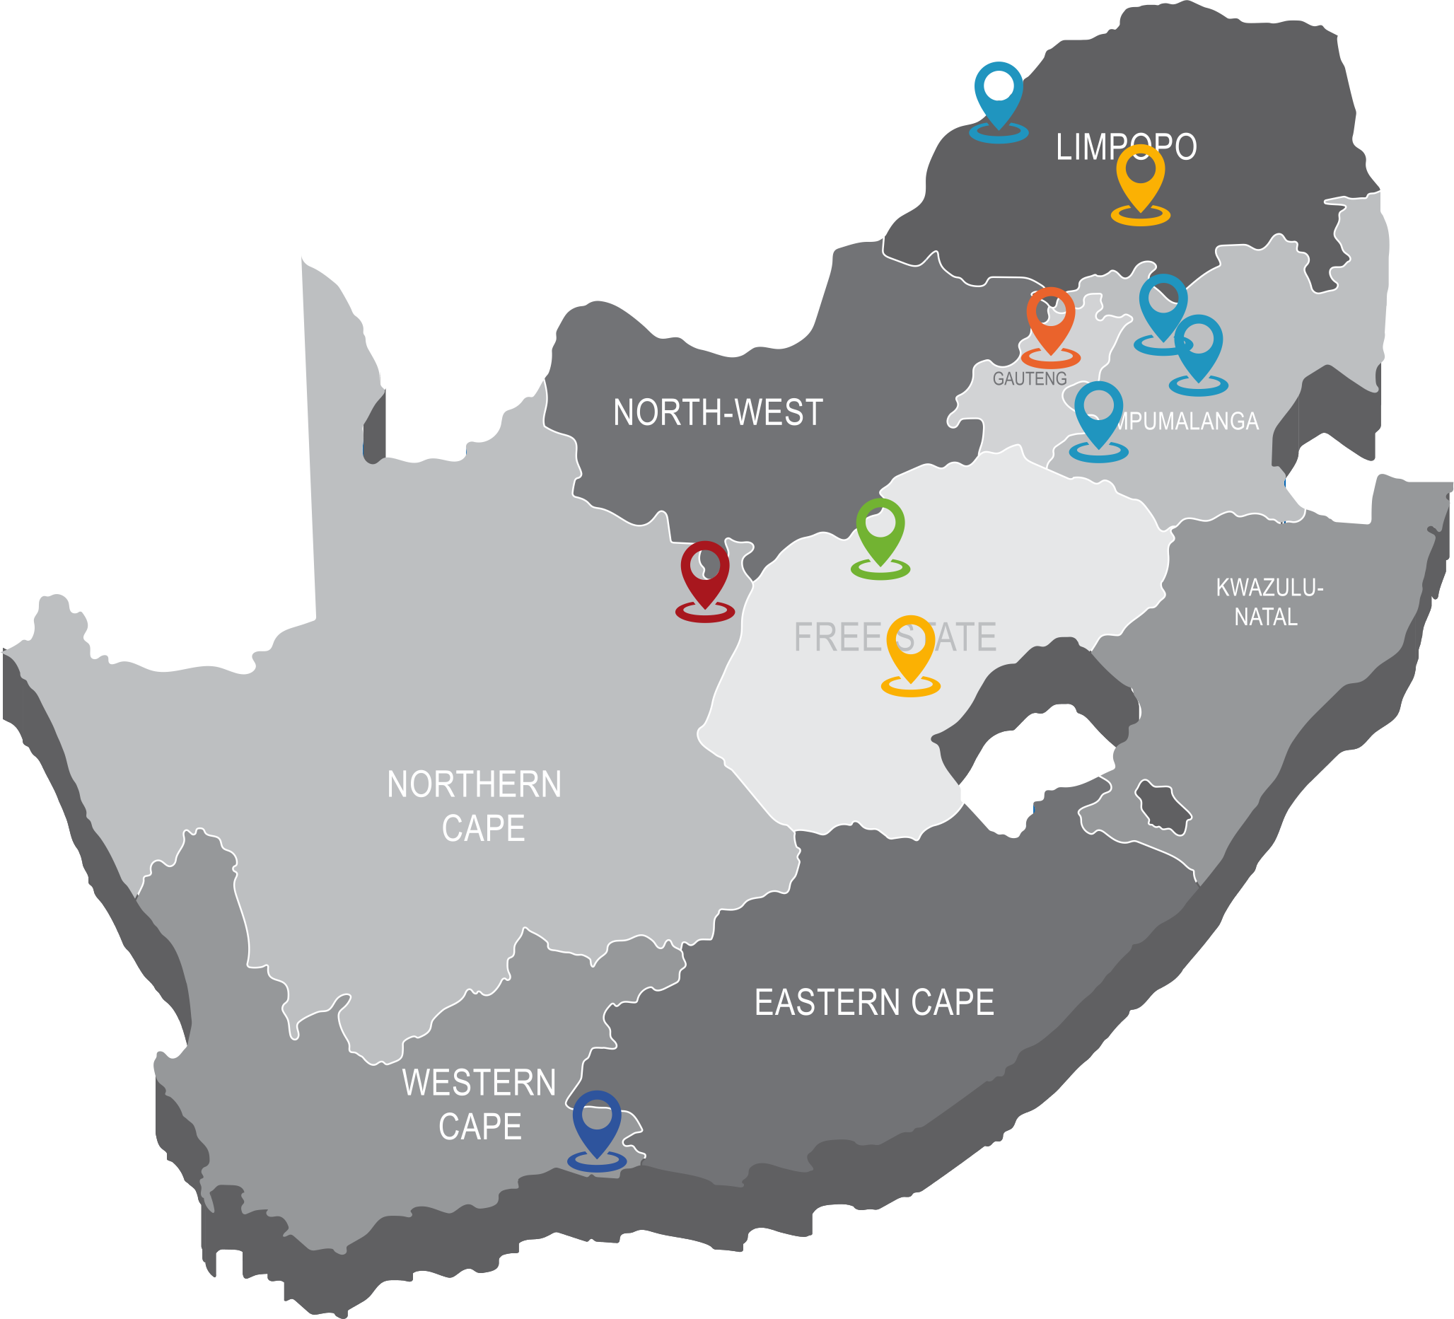
GBVF NSP LOCALISATION

Slide 3
operations Gauteng, Limpopo and Mpumalanga
Economic Empowerment

Slide 4
NSP key interventions
Demonstrated commitment through policy interventions by the South African state, private sector and other key stakeholders to eliminate the impact of economic drivers of GBV;
Accelerated initiatives that address women’s unequal economic and social position
Safe workplaces that are free of violence against women and LGBTQIA+ persons, including but not limited to sexual harassment;
Strengthened child maintenance and related support systems to address the economic vulnerability of women

Slide 5
Focus, Goal and Stakeholders
100-Days Challenges

Slide 6
Focus Area
100-Day Goal
Stakeholders
Awareness and Education
Safe workplaces, free of violence against women and LGBTQIA+ persons, including but not limited to sexual harassment.
Each operation at Exxaro created its own work plan, and the Woman in Mining Committee chairpersons formed a joint team to collaborate on the overall 100-Day Challenge.
Partnership and Support
Diversity and Inclusion

Slide 7
Focus Area
100-Day Goal
Stakeholders
Increase engagement on GBVFH at Exxaro and during the 100-Days start a campaign to get 10,000 pledges.

Slide 8
Focus Area
100-Day Goal
Stakeholders
Dept of Mineral Resources and Energy
Mineral Council
Office of the President
Exxaro CEO and Executives
Women in Mining Committees
Employees
Exxaro Board
Communities
Human Resources
Communication department
South African Police Services
Operations management
End GBVF Collective
Tears foundation

Slide 9
Experiments, Innovations and Action
100-Days Challenges

Slide 10
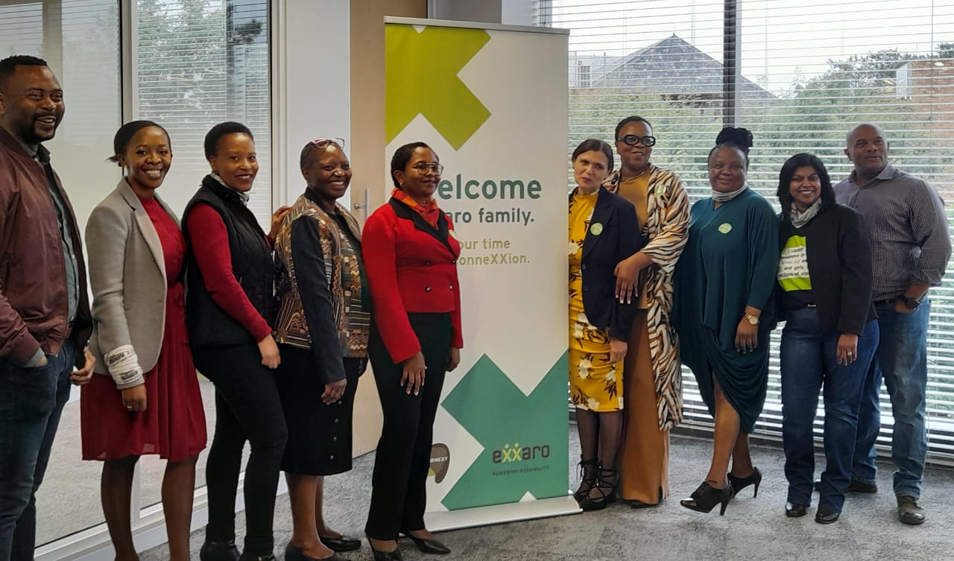
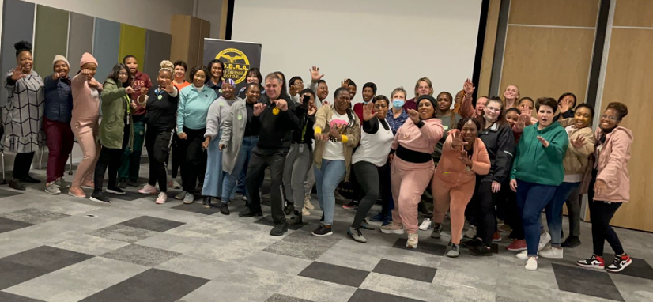
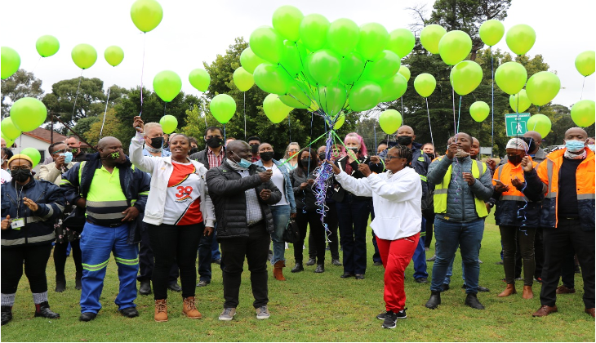
Launch Event
Gauteng - Corporate Office
Exxaro’s launched the Gender-Based Violence and Femicide (GBVF) 100-Day Challenge with the Presidency and the Minerals Council of South Africa (MCSA) on the 4th of April 2022
Campaign theme: Inclusive and empowerment
Self-defence classes
Group policies and reporting systems
Suggestion boxes
Community outreach

Slide 11
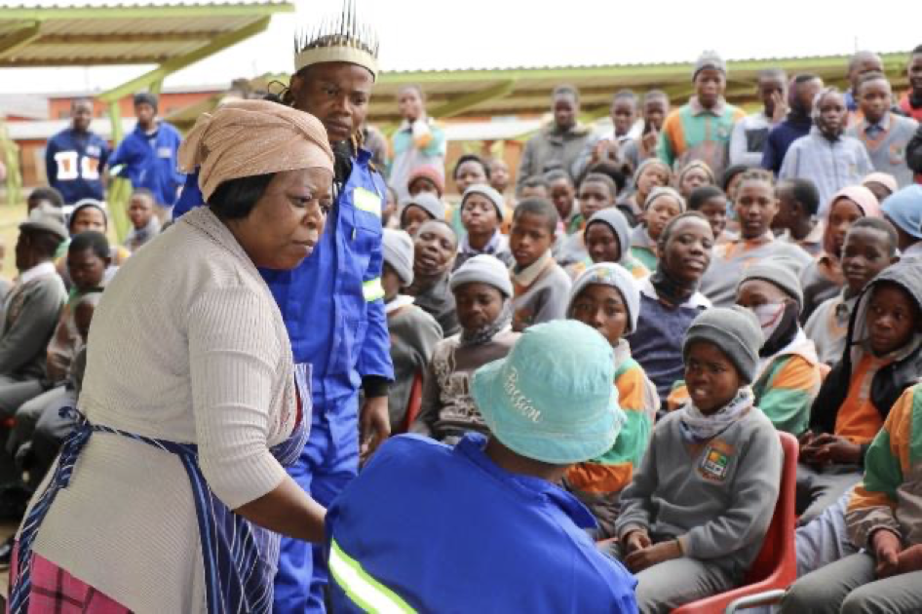
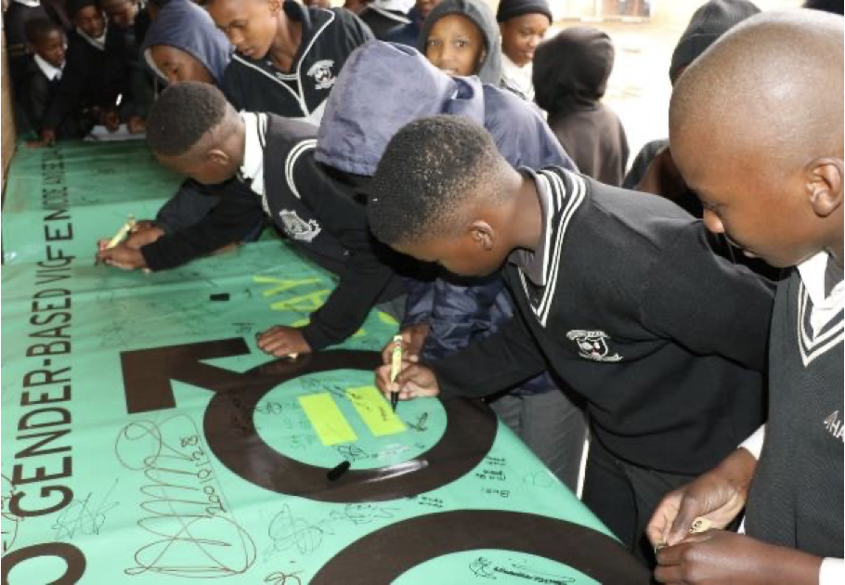
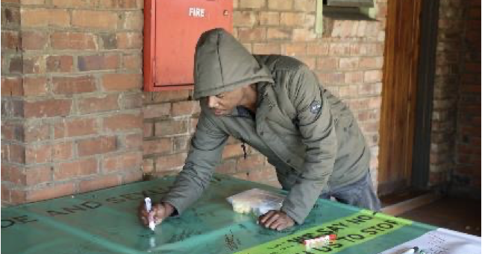
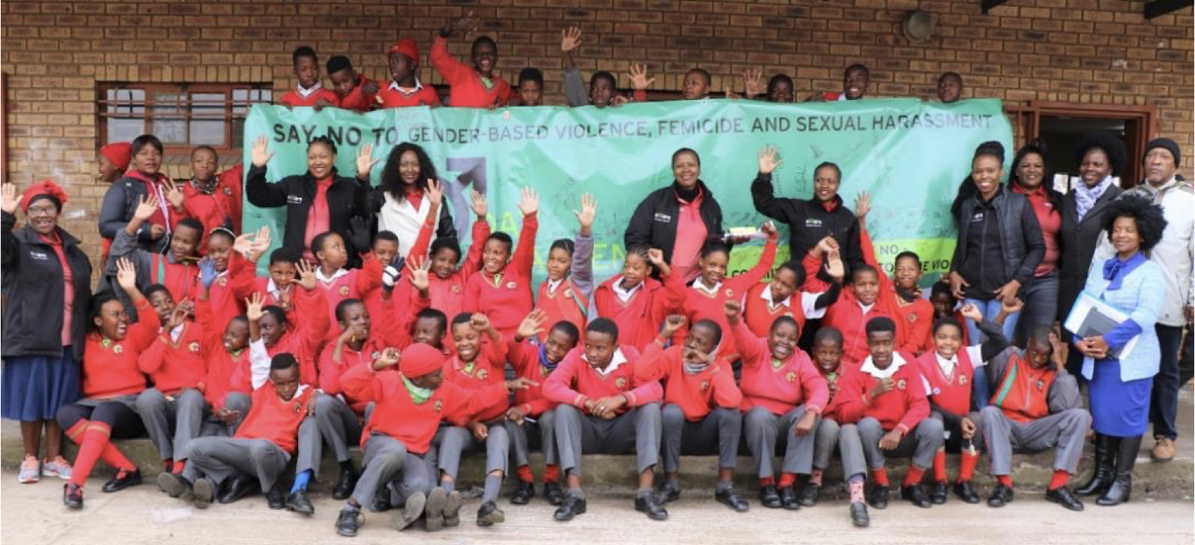
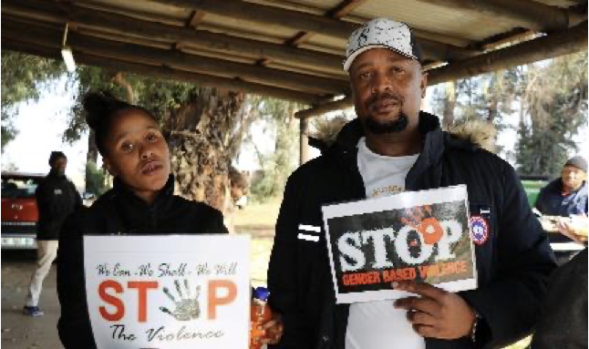
Leeuwpan
Campaign theme: Breaking the silence
Safer environment campaigns
Community outreach
Awareness - Imbizo interactions
Beyond 100-Day activities
Roll out of GBV campaign to primary schools in our community
Education books
Videos were produced Sexual Harassment Policy
Shared video with SAPS
Employees made pledges
Posters and pamphlets for all Primary Schools in Botleng with Hotline numbers
Industrial Theatre for employees (Budget permitting).
Continuous awareness & engagement on GBV, Femicide and Sexual Harassment

Slide 12
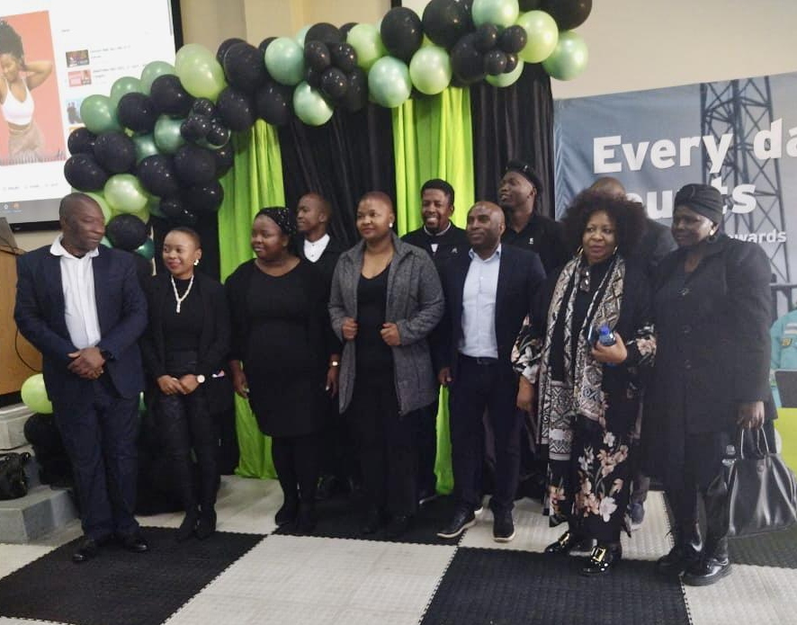
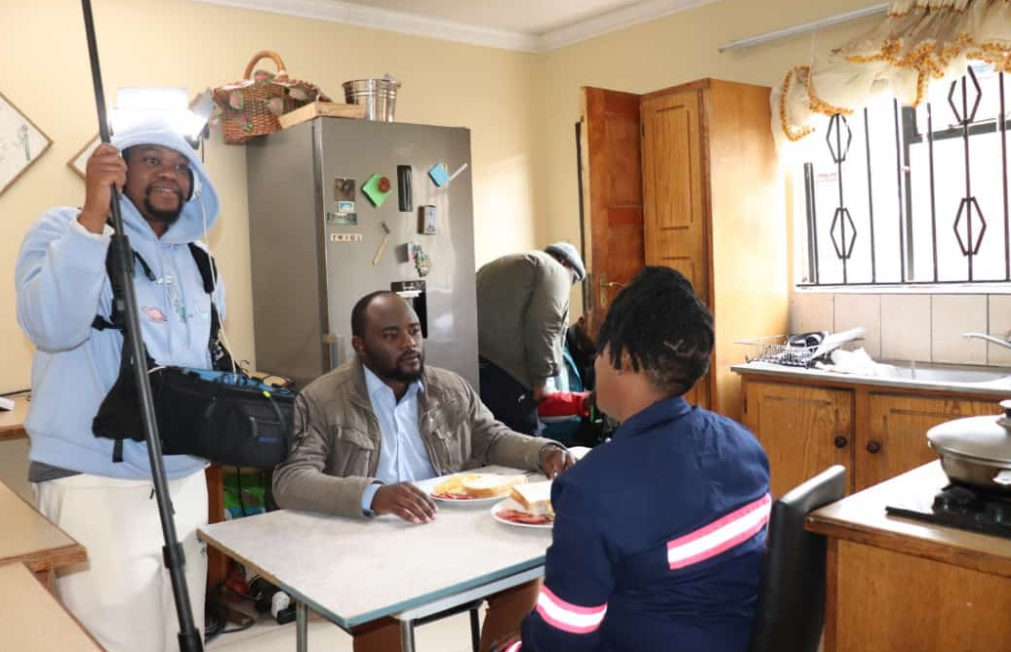
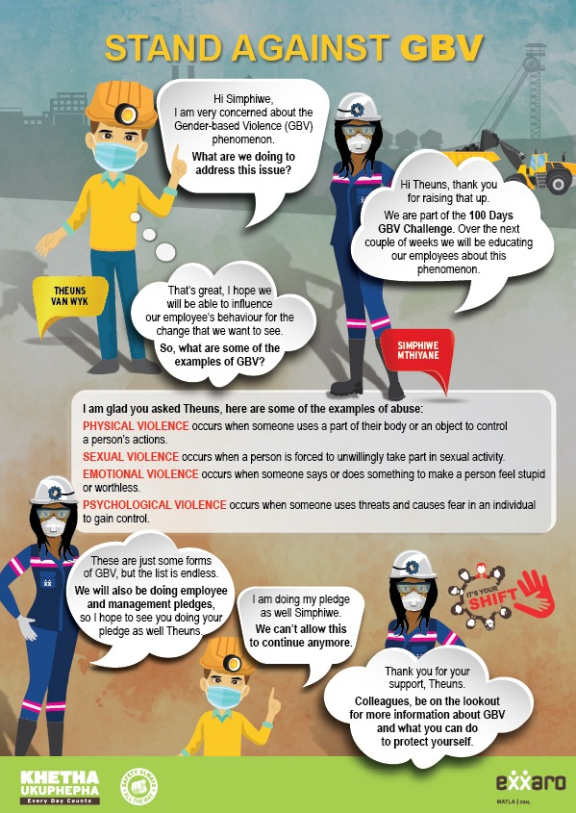
Matla
Campaign theme: Stand against GBV
Stand against GBV campaign
GBVF Monster in My house video series
Ibandla Event
Reporting system
Internal brief
Video of management pledges
HR Sexual Harassment toolkit
Comic strip
The team has commissioned a 12 episode film which provides a deepened understanding on GBVF drivers and sexual harassment.
Breaking silence from male employees
Prevention safety and response
Beyond 100-Day activities

Slide 13
Grootegeluk
Belfast
Campaign theme: Every day, I rise to thrive
Campaign theme: Breaking the silence
Women’s safety initiatives
Internal
Comms campaign
Schools engagements
Partnership with Tears Foundation
Survey – Understanding the barriers
Women’s month
120 people participated in a survey on sexual harassment and GBV
The campaign will officially close out during Women’s month with outputs from the campaign and messages
Anonymous report line
Employees pledging videos
Women’s month campaign

Slide 14
Insights gained and lessons learned
100-Days Challenges

Slide 15
Sexual harassment indicators
1
Collaboration across operations
Community outreach
8
2
Learnings
7
3
Red Tape
Diverse team
6
4
5
Urgency creates focus and creativity
Management support
Storytelling

Slide 16
Insights and Recommendations
Sexual harassment indicators
Collaboration across operations
Diverse team
Urgency creates focus and creativity
In a campaign, have a clear goal and don’t be scared to go for big goals.
Improve on the reporting systems and integrate data from various reporting channels
Get a critical mass to engage, to create a tipping point
Peer learning enhanced operations activities.
Expand the initiative across the mining sector.
Mining houses should pull resources together and create service points near operations
Inclusivity by seeking guidance and ideas from all employees
Start conversations with men earlier.
Involve the community in the 100-day team
Do not be scared to experiment and try a new way of doing
Celebrate small victories along the way

Slide 17
Insights and Recommendations
Storytelling
Management support
Red tape
Community outreach
Storytelling rather than speeches create interest and engagement
Use media platforms to create awareness and have GBV dialogues
“talk” GBVF daily
Managers lead by example - Engage them early to get buy-in and support.
GBV & sexual harassment should be on all agendas, not an add-on
Tackle procurement red tape as soon as possible
Involve procurement process/funders in the 100-day team
Employees are part of a community and their kids in schools
Expand the outreach to all educational institutions
Partner with NGOs to provide support

Slide 18
The Results
100-Days Challenges

Slide 19
Results
Increase engagements on GBVFH at Exxaro in 100-Days and start a campaign to get 10,000 pledges
1550
5200
Employees engaged
Action pledges so far …
The education and awareness campaigns saw a remarkable increase in the reporting of sexual harassment cases

Slide 20
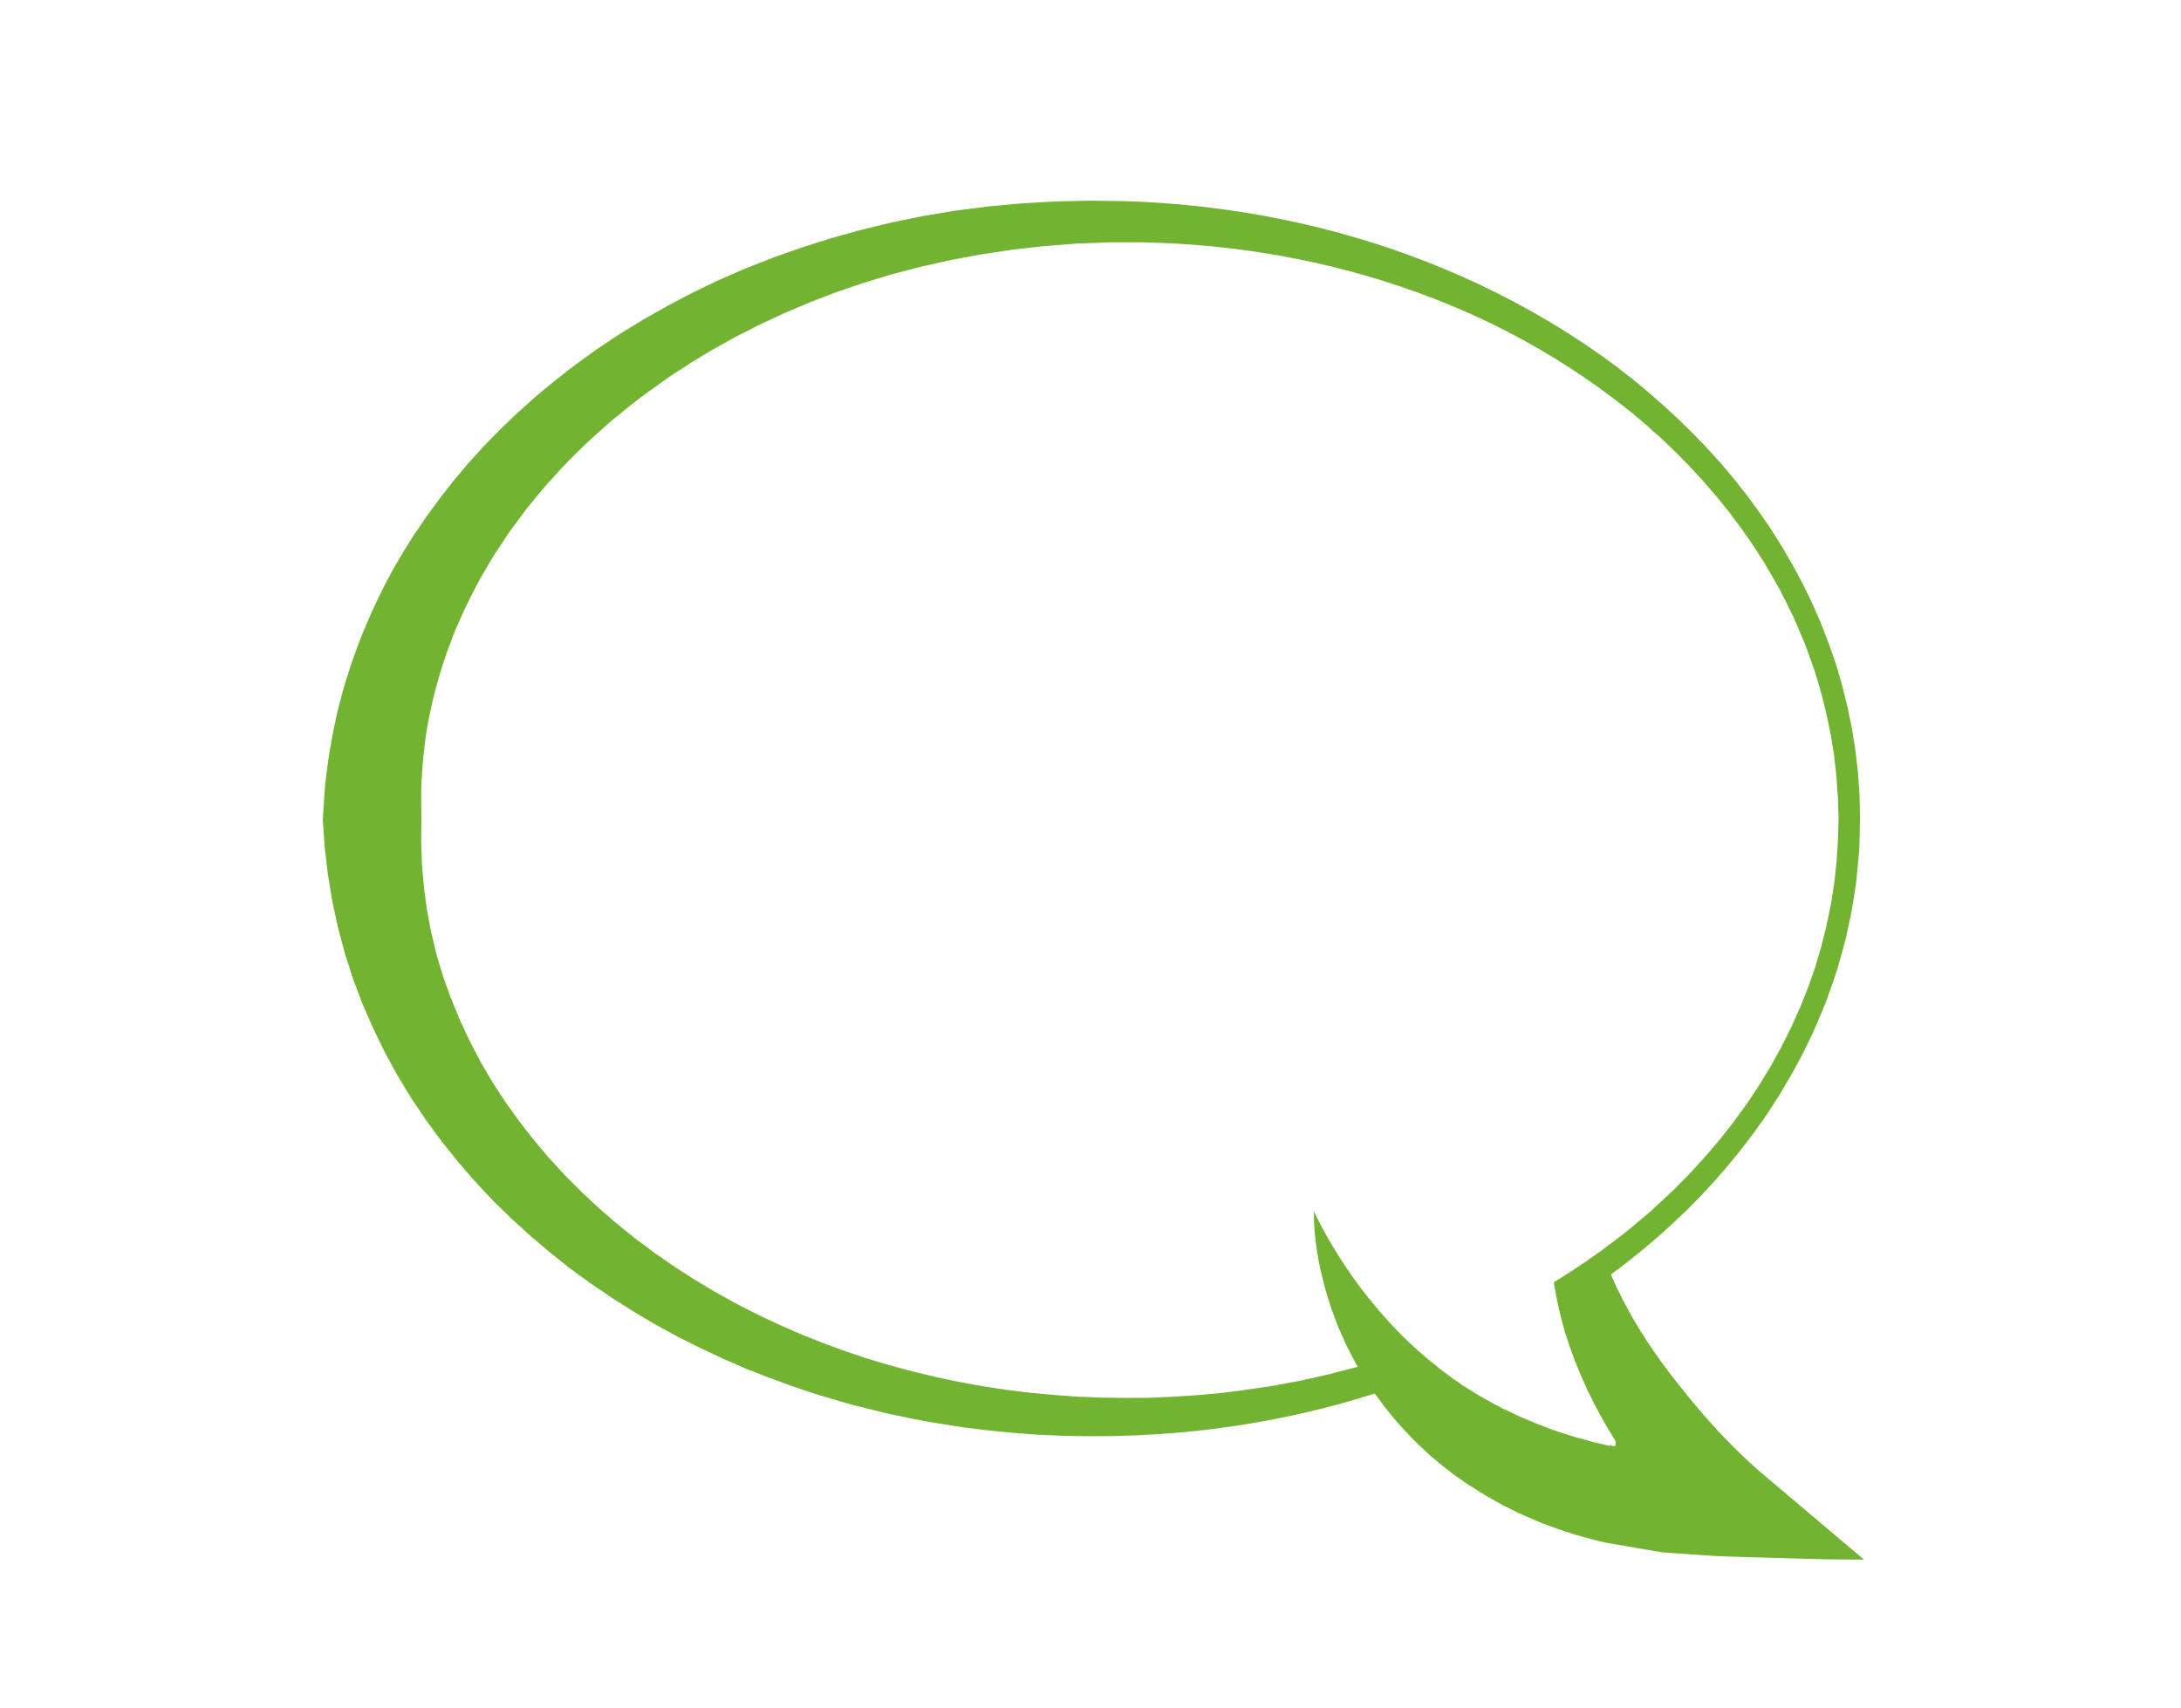
GBV+F affect each and every one of us. Have passion, be a Team Player and be open-minded and be prepared to experience new challenges and be a change maker.
We have an opportunity to change the narrative about GBVF and the mining industry.
I want to spread and share from the Rooftops about what the teams achieved and did.
This challenge has been the most intense in terms of commitment, innovation, teamwork not to mention impacting people's lives, I am honoured to have been afforded this opportunity and chance.
The pressure showed us what is possible
The teams have done more than I could have imagined - I am pleasantly surprised.
You touch women you have moved the Rock. This 100-day challenge was not just turning lemons into lemonade it was like being given 20c and turning it into a gold coin - this is what the business units have done.
IMPACT IN 100 DAYS

