Slide 1
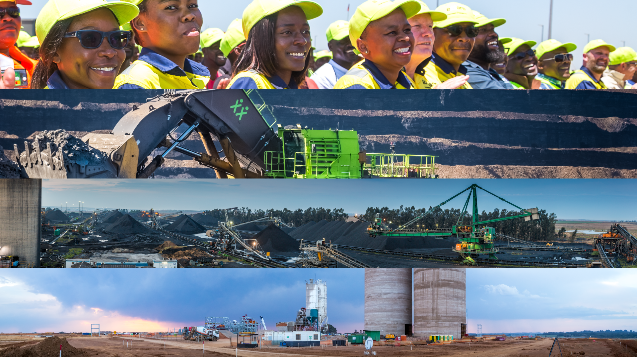



South African Investment Conference Media Tour
31st of October 2019
Dr. Nombasa Tsengwa
Executive Head Coal Operations
Notes:
Date and title
Top image – non contractor
Cut lady

Slide 2
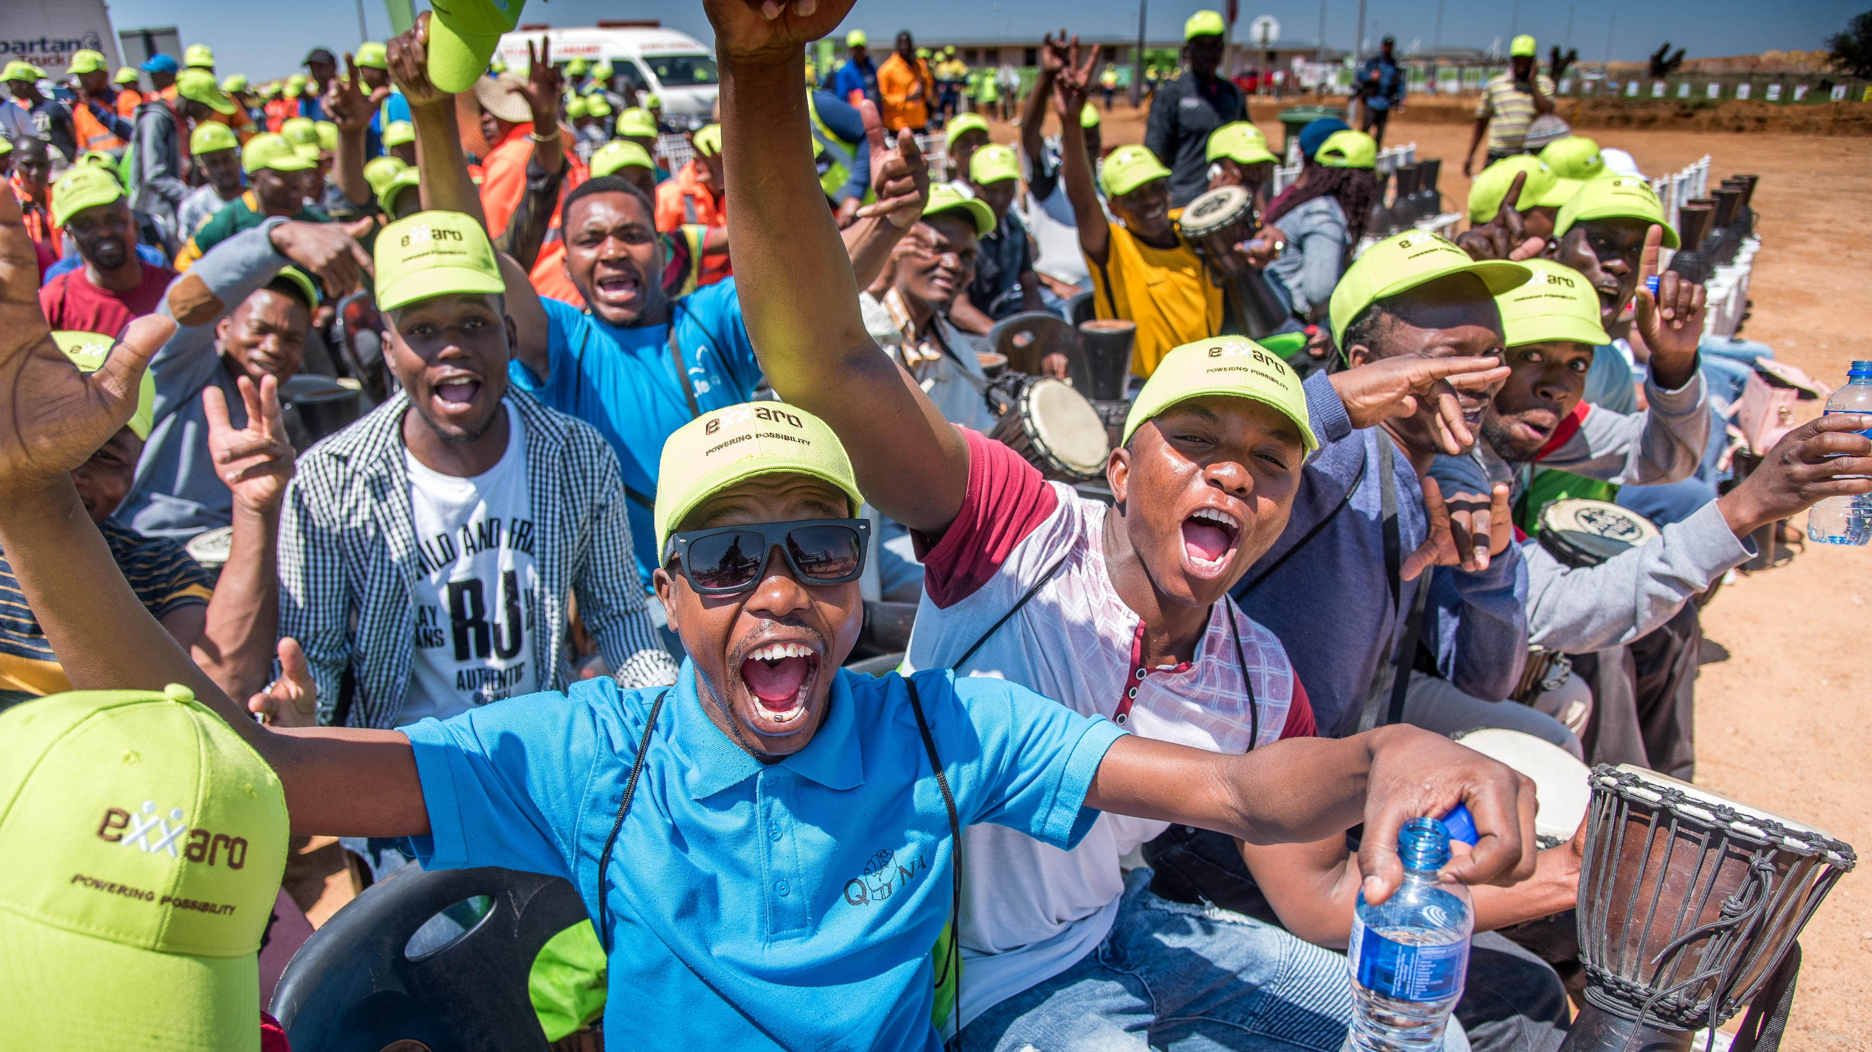
30%
Empowered South African Coal Mining Company
R44Bn
with Market
CAP of
….as at Monday 28 October 2019

Slide 3
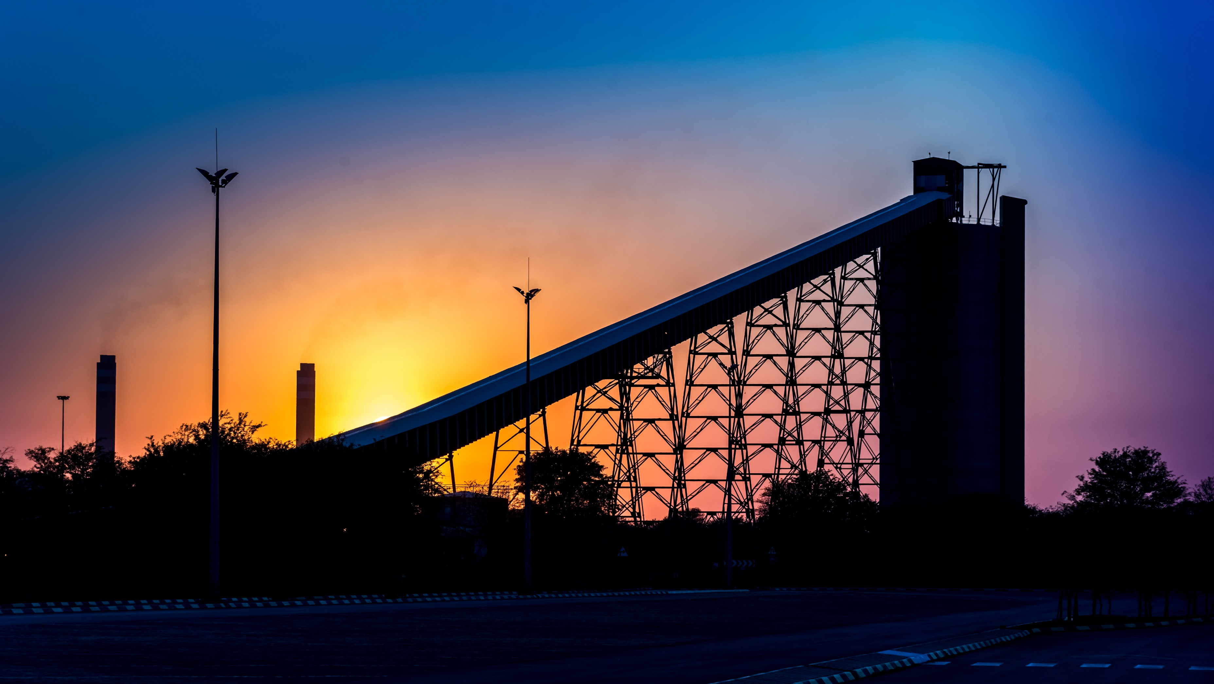

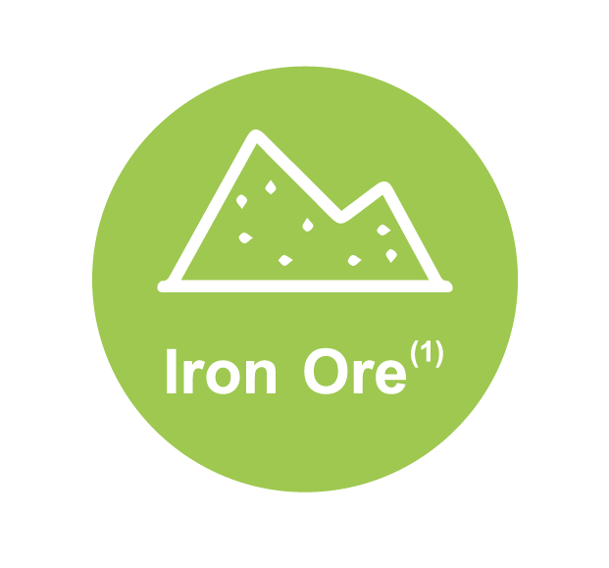
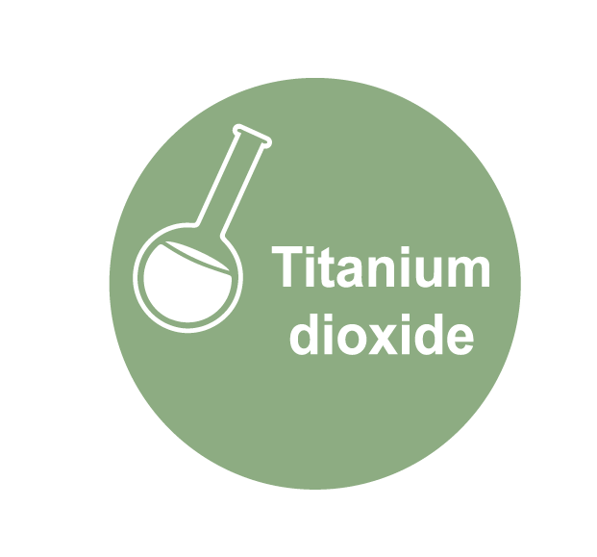



Strategic Investments in Other Natural Resource Assets
10% interest in Tronox
Exxaro owns 20.6% in Sishen Iron Ore
24% interest in
Black Mountain
50% interest in Cennergi
……Intent for 100%

Slide 4
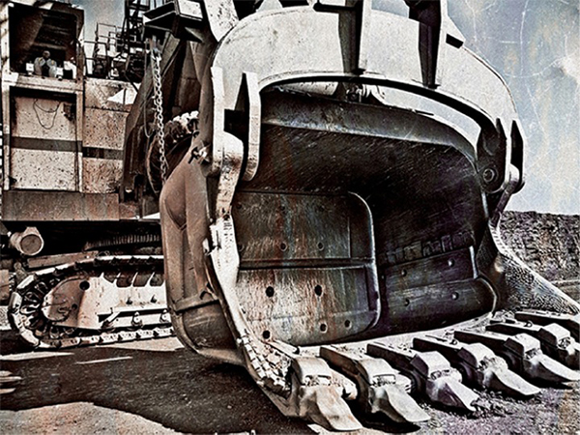
Safety is our Number One Priority
2 Fatalities
1 Fatality
1 Fatality
Safety performance improved 52% in group LTIFR over the past 8 years
Zero fatalities in the last 30 months
*LTIFR = Lost time injury frequency rate per 200 000 man hours worked

Slide 5


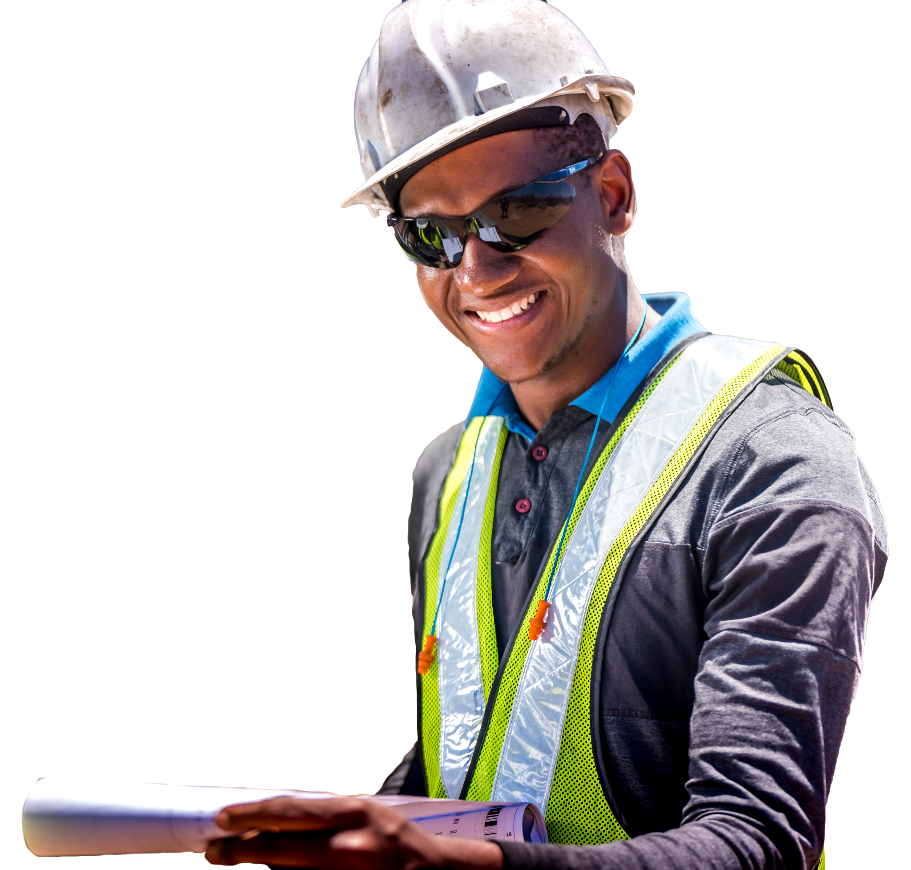
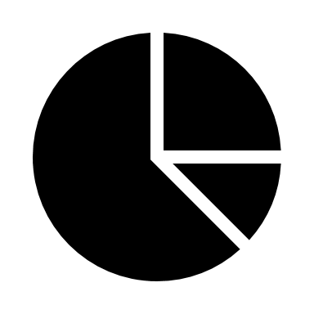


Coal │ Our Strategy
….is to be cost competitive and capital efficient, across our entire business value chain, maintaining a robust asset and volume base, diverse product mix using innovation and intelligence to quickly respond to market changes!
Safety at reduced cost
Robust Assets and Volumes
Mpumalanga Operations
GG Operations
Growth Projects
Capital
SIB
Growth
Product Mix
Market to Resource (M2R)
Market Intelligence
R/t and Productivity Improvement
Digital@Exxaro
Operational Excellence
Quick “Market to Resource” response

Slide 6
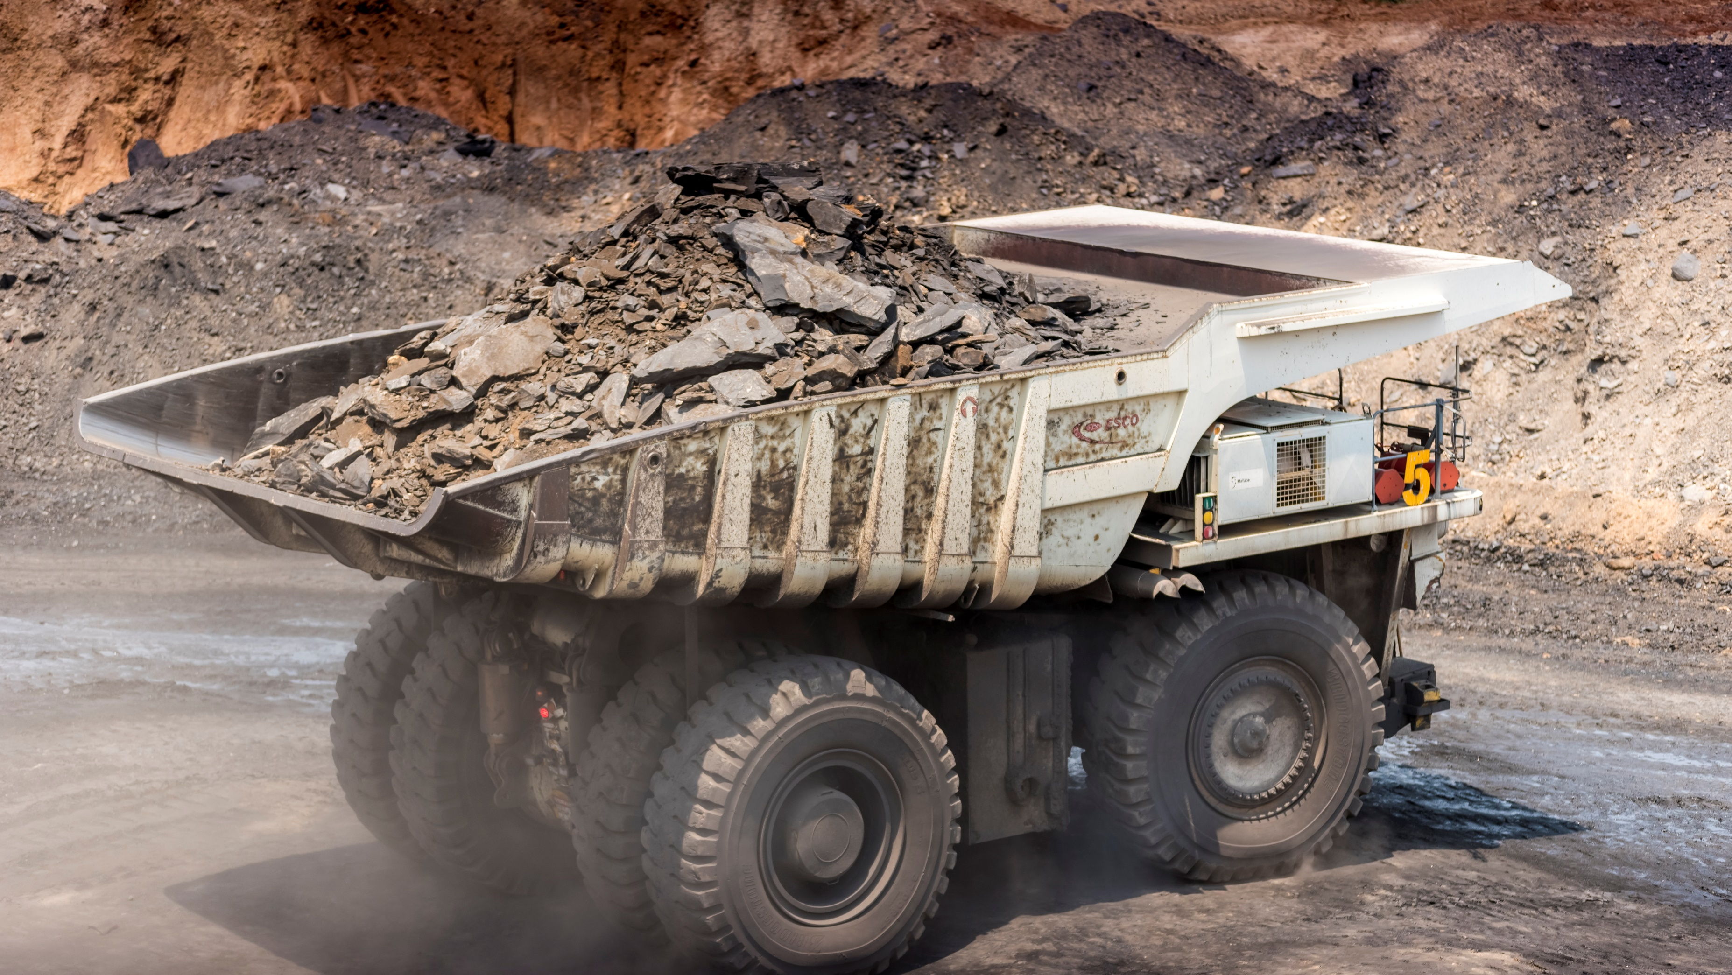
Exxaro Coal Business at a Glance
Exxaro is the largest supplier of coal to Eskom and 4th largest coal exporter of thermal coal in South Africa.
Exxaro is geared to produce ~60 Mt by 2023
Exxaro is the most diversified multiproduct producer. i.e. sized product at mine level and export product mix at RBCT.
Current Saleable Mix*
Sized Products
Semi Soft Coking Coal
2
Mtpa
Export thermal coal
Duff
Peas
Small nuts
Semi-Coke
Middlings
9
Mtpa
Local Power Station Coal
36
Mtpa
*Exxaro Internal View

Slide 7
Exxaro Coal Business at a Glance… continued
Exxaro has a robust export product portfolio that will be skewed towards higher quality coals in future

Slide 8
Exxaro is Currently the Largest Coal Producer in South Africa…
2018 Product Tons Production (Mt)
Notes:
Number update - confirm

Slide 9
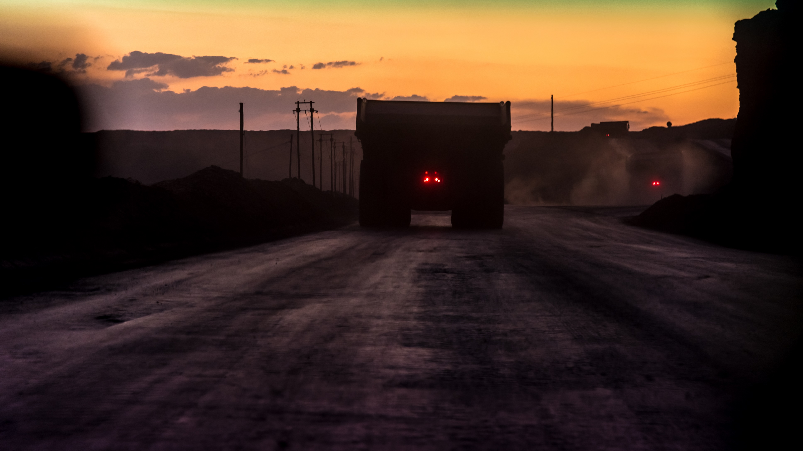
Coal Operations in Mpumalanga and Limpopo
Grootegeluk
Market: Domestic and Export
Product: Thermal, Met and Coking Coal
Life of Mine: 35+ years
Production: 29.7 Mtpa
1
1
4
Mafube (50% ownership)
Market: Domestic and Export
Product: Thermal Coal
Life of Mine: 15+ years
JV with Anglo Coal
Production: 3.4 Mtpa
Limpopo
2
Leeuwpan
Market: Domestic and Export
Product: Thermal
Life of Mine: 11+ years
Production: 3.8 Mtpa
5
ECC Complex (5 Operations)
Market: Domestic and Export
Product: Thermal Coal
Life of Mine: 21+ years
Production: 4.7 Mtpa
4
6
2
3
5
3
Matla
Market: Domestic (Eskom)
Product: Thermal Coal
Life of Mine: 20+ years
Production: 10 Mtpa
Mpumalanga
6
Belfast Coal
Market: Export
Product: Thermal Coal
Life of Mine: 17+ years
Production: 2.7 Mtpa

Slide 10
GG: Is the Largest Coal Mine in the Southern Hemisphere operated from a single footprint
2018 Product Tons Production (Mt)
Notes:
To check numbers

Slide 11
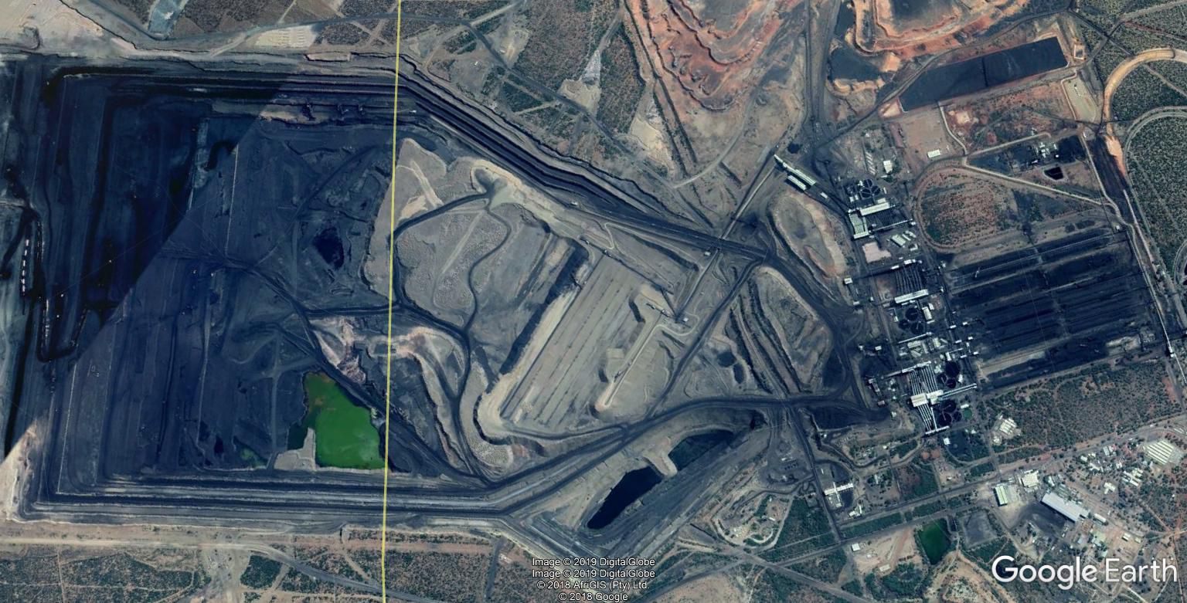
GG: Largest Coal Mine on a Single Footprint
OPEN CAST MINE
BENEFICIATION PLANTS
` 4 Km
120m Deep
Surface area 1200 ha
` 3 Km
9 PLANTS IN TOTAL
WORLDS BIGGEST FOR COAL PROCESSING

Slide 12






Exxaro Coal is Geared for Growth
Operational Excellence is embedded, resulting in 4% ROM tonnes improvement
Year on Year from 2016 - 2018
Group Core EBITDA has shown a +18.6% increase (Year on Year from 2016 – 2018)
We have a strong balance sheet
Strategically positioned for both domestic and export coal markets
Export to seaborne markets through the RBCT with 9 Mpta (~ 11Mtpa @ 91Mtpa). Almost doubling up in 2023 depending on export logistics
Optimising product mix to supply higher value segments and customers
Notes:
Geared statement to replaced emp export and increasing
Group Core EBITDA has shown a +18.6% increase from 1H16 to 1H18.

Slide 13
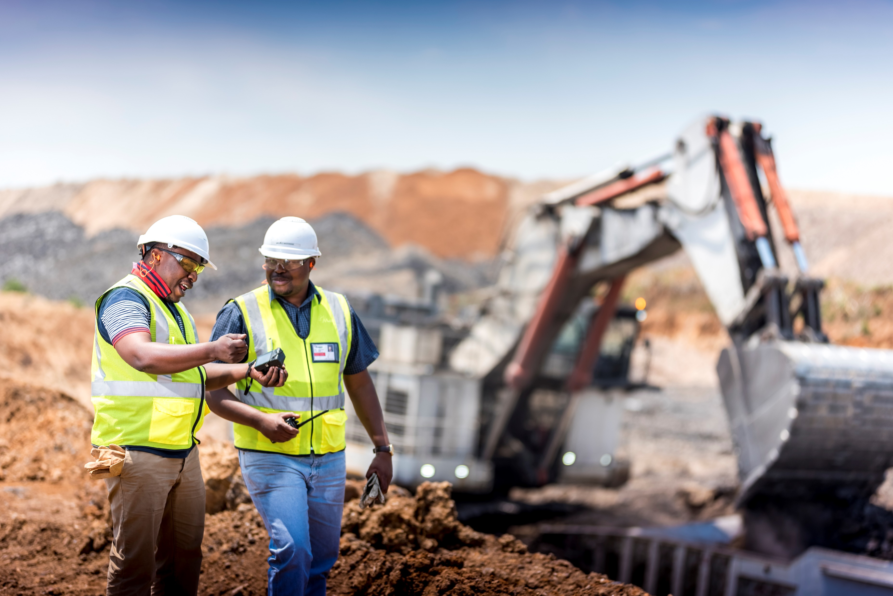
R20 Bn
Allocated for growth projects
up to 2023

Slide 14
We continue to Lead Growth Options
in Coal with New Projects
4
Mafube Lifex JV
Capex: R2 Bn
Production: +3.4 Mtpa
5
Leeuwpan Life Extension
1
Grootegeluk Rapid Load Out Station
GG6 Expansion
2
1
Capex: R0.6 Bn
Production: +2.7Mtpa
Capex: R6.1 Bn
Production: +1.6Mtpa
Limpopo
6
Matla Mine 1 Relocation
2
Thabametsi Phase 1
Capex: R1.8 Bn
Production: +4Mtpa
Capex: R3.2 Bn
Production: +3.9Mtpa
4
7
5
6
3
Mpumalanga
7
Belfast
3
Dorsfontein West
Capex: R3.3 Bn
Production: +2.7Mtpa
Capex: R0.4 Bn
Production: +1.5Mtpa
Notes:
Check numbers
Numbers in green

Slide 15
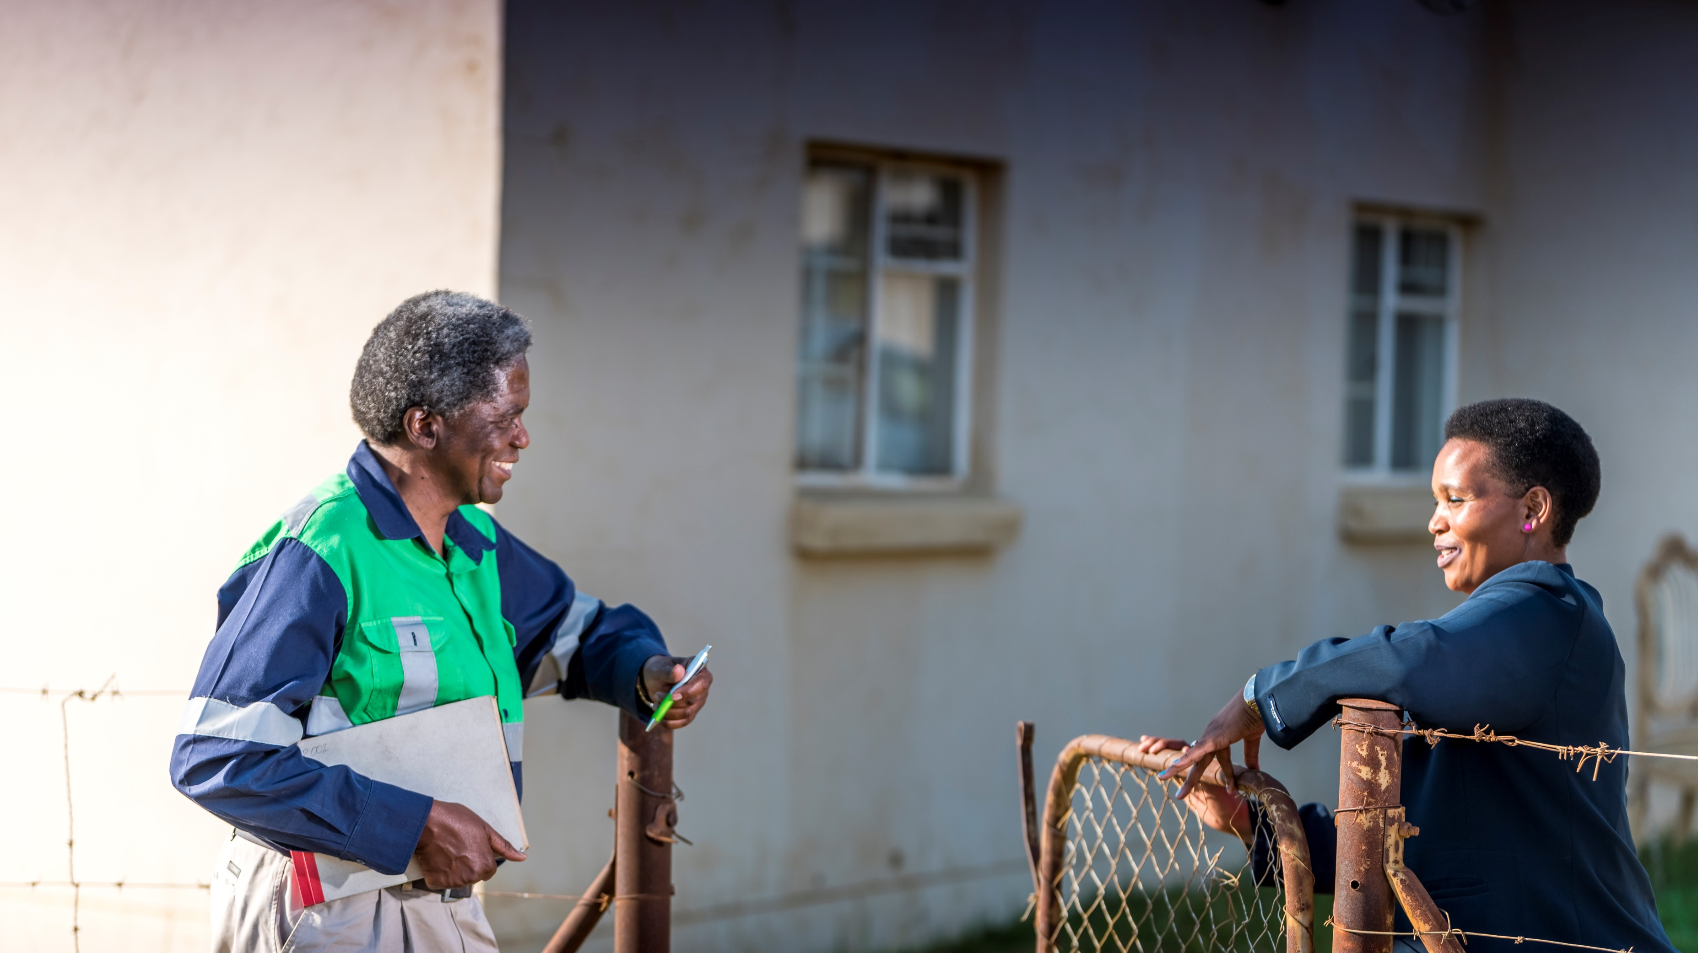
Our People,
Communities, and Environment

Slide 16
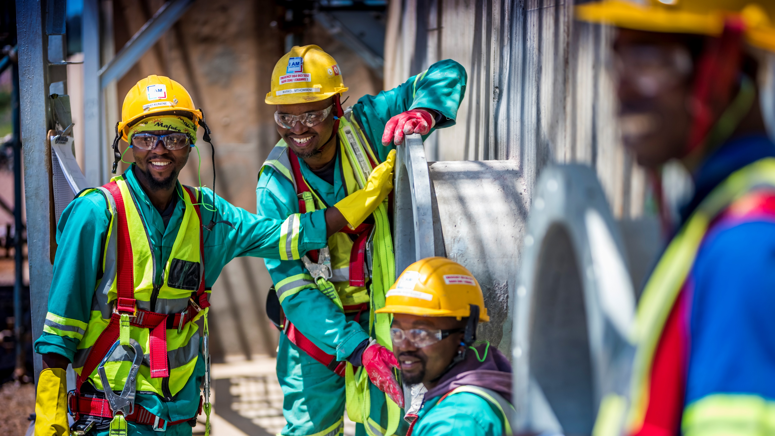






Exxaro Cares
More than 5% of payroll spent on training and people development.
R935m spent on communities in the last 10 years. Benefitting more than 20 000 people.
We met majority of our water efficiency targets.
Land rehabilitation is 21% of total disturbed land.
Returned R25,5 Bn to shareholders since 2006 to 2018.
R22.4 Bn spent on black owned suppliers (R8.5 Bn was on black women owned).
Over R215 million invested in developing small black owned suppliers (2018 -2019).
Notes:
Back up to

Slide 17



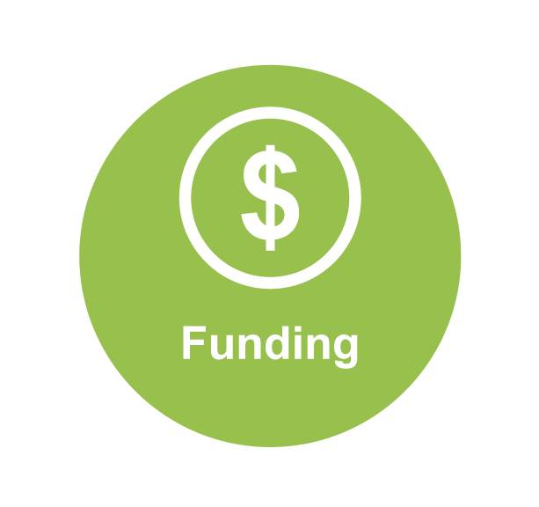

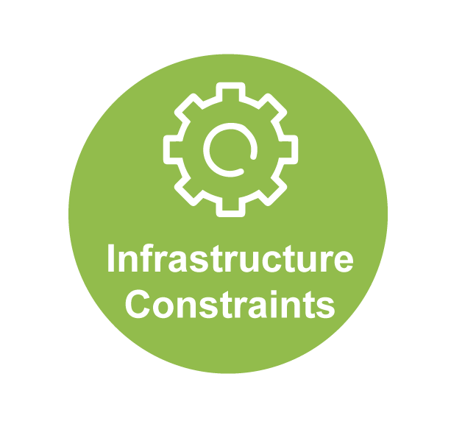
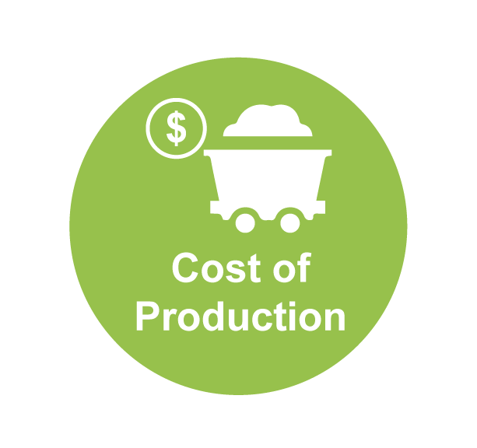
Current Mining Operating Environment/Conditions

Slide 18
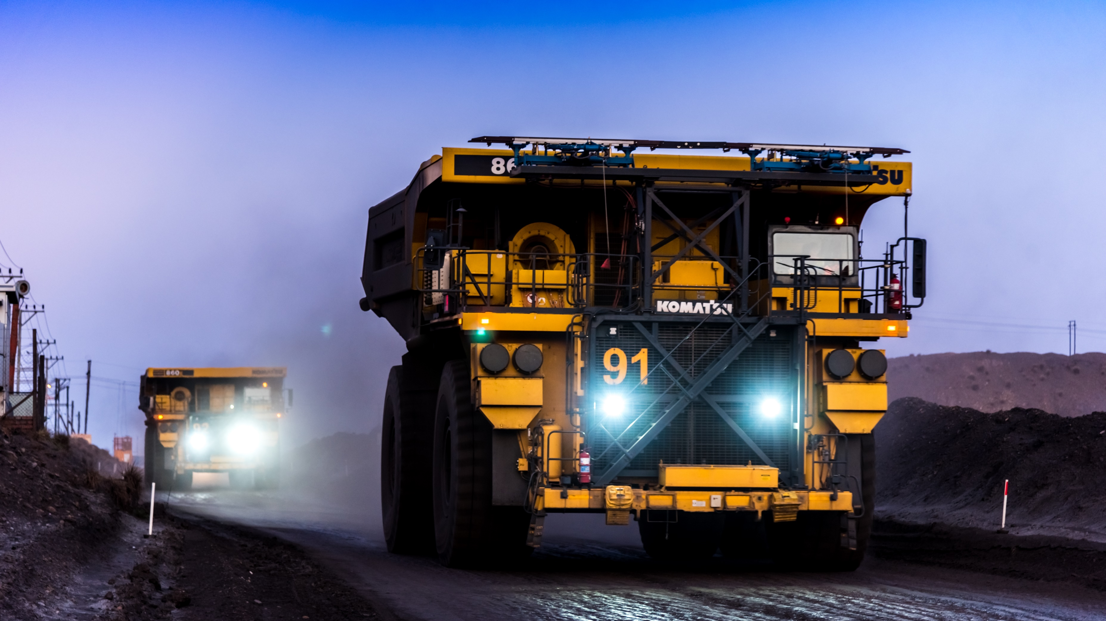
  We Believe in the Future of Coal
  We have growth in volume, product mix, balance sheet and value
  “Digital@Exxaro” is the defence to the future and relevant to current conditions

Slide 19
THANK YOU

