Slide 1



Pleasure Mnisi
Manager, Business Optimisation
Exxaro Coal

Slide 2

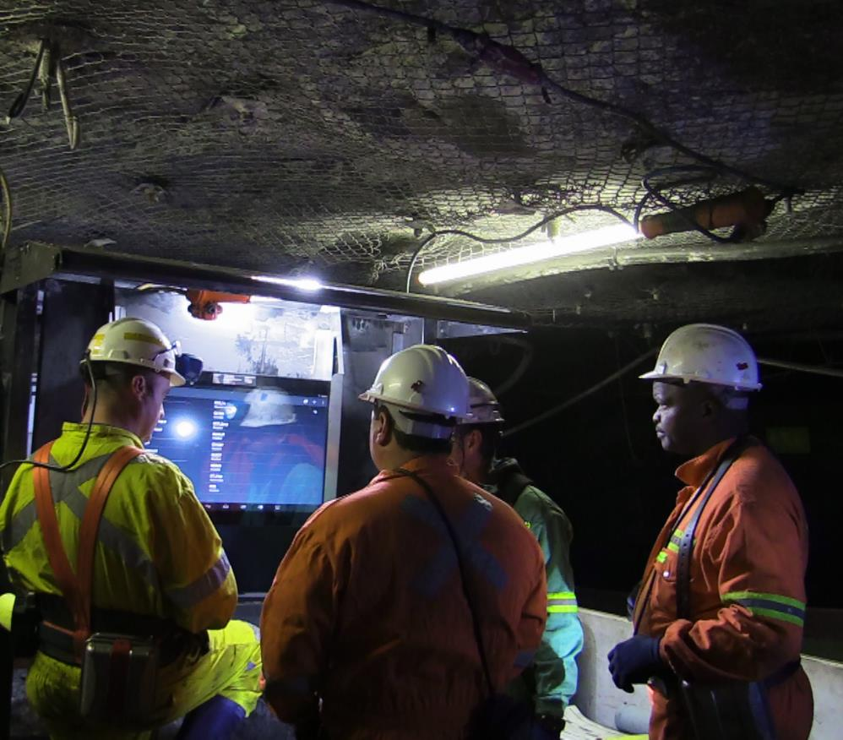
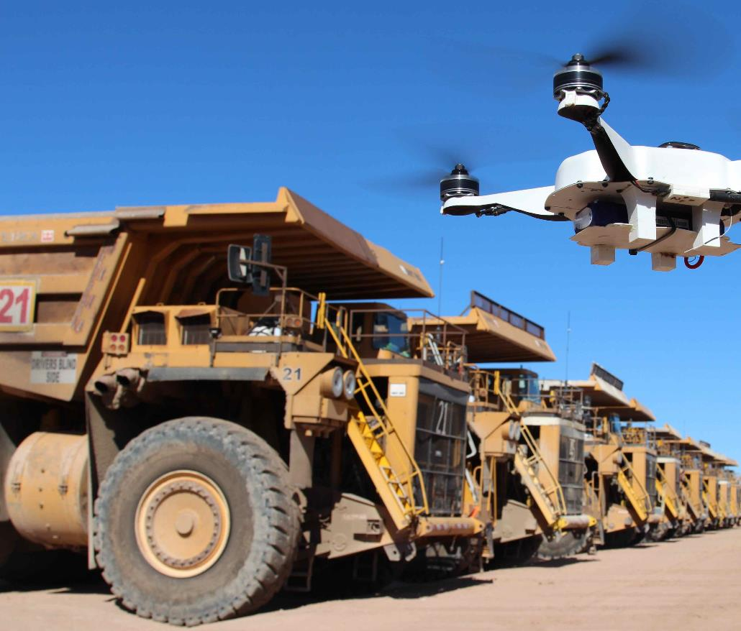
THE MINING INDUSTRY IS ON THE BRINK OF A TECHNOLOGICAL REVOLUTION

Slide 3


Our goal is
to achieve
25%
PRODUCTIVITY
improvement using
DIGITALISATION
AND INNOVATION

Slide 4
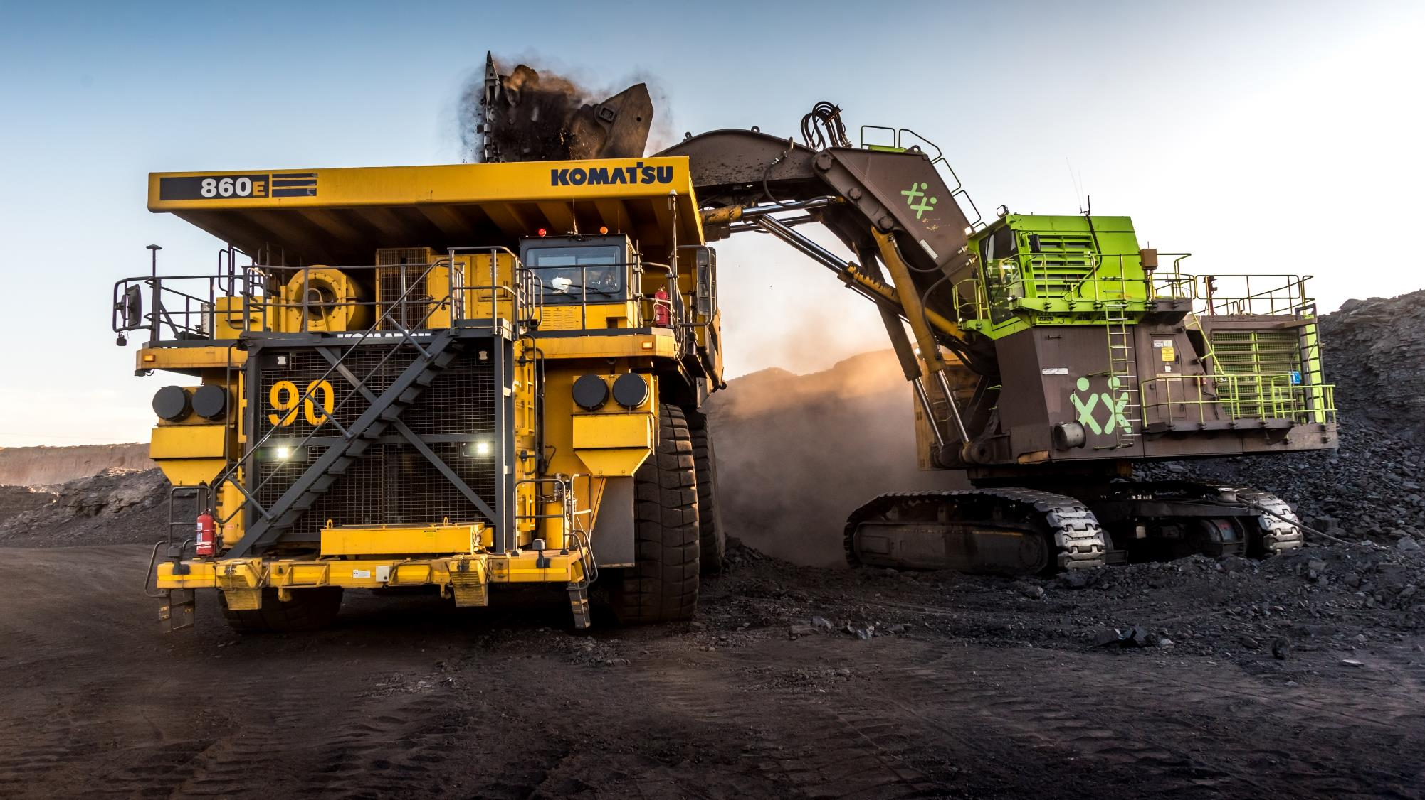



THE 3 BIG CHALLENGES?
1
3
2
Where to start
How to realise the value
Start up culture
Notes:
No changes

Slide 5



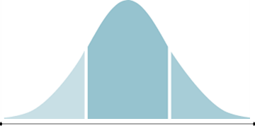



Where to start | Our program is geared towards improving productivity and reducing cost
P75
Lean5
Operational Excellence
Constraint focused
Cost Reduction
Productivity Improvement
Risk Mitigation
Yield/Product Optimisation
Bias for action
Performance management
Ownership of OE by line
Incentive system
Span of control
VCV through IoC
M2R Optimisation through ME
Empowered Workforce
Developing our D@E Core Competencies
Resource & Mining Innovation Magnet
Performance Benchmarking
Reducing variation
Increasing consistency
Review of P75 Targets Yearly
Achieving 2023 Strategy
Productivity Improvement
Cost Reduction
Safety Always
Business Optimisation System Implementation across at all operations (MOS)
Consolidation & Banking of Coal Strategy
“XXX” – Value Consolidation

Slide 6
Where to start | Progress to Date
EMBED
AND
IMPROVE
Visualisation of the Value Chain
Achieved
Integrated Operations Centre
Data science
Predictive Maintenance and Reliability
Focus
MRM Integration
Automation

Slide 7


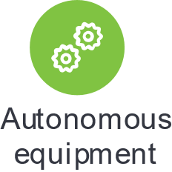
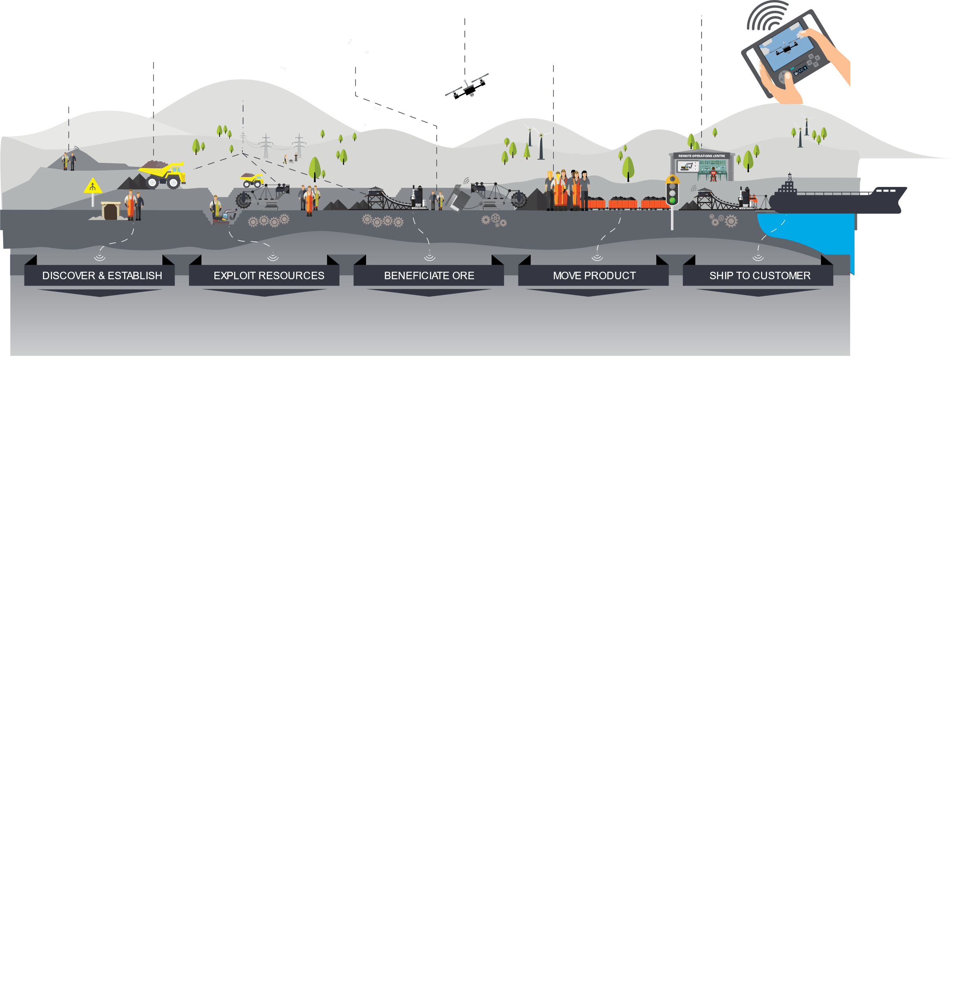


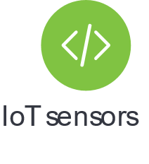


Where to start | A Digital And Connected Mine

Slide 8
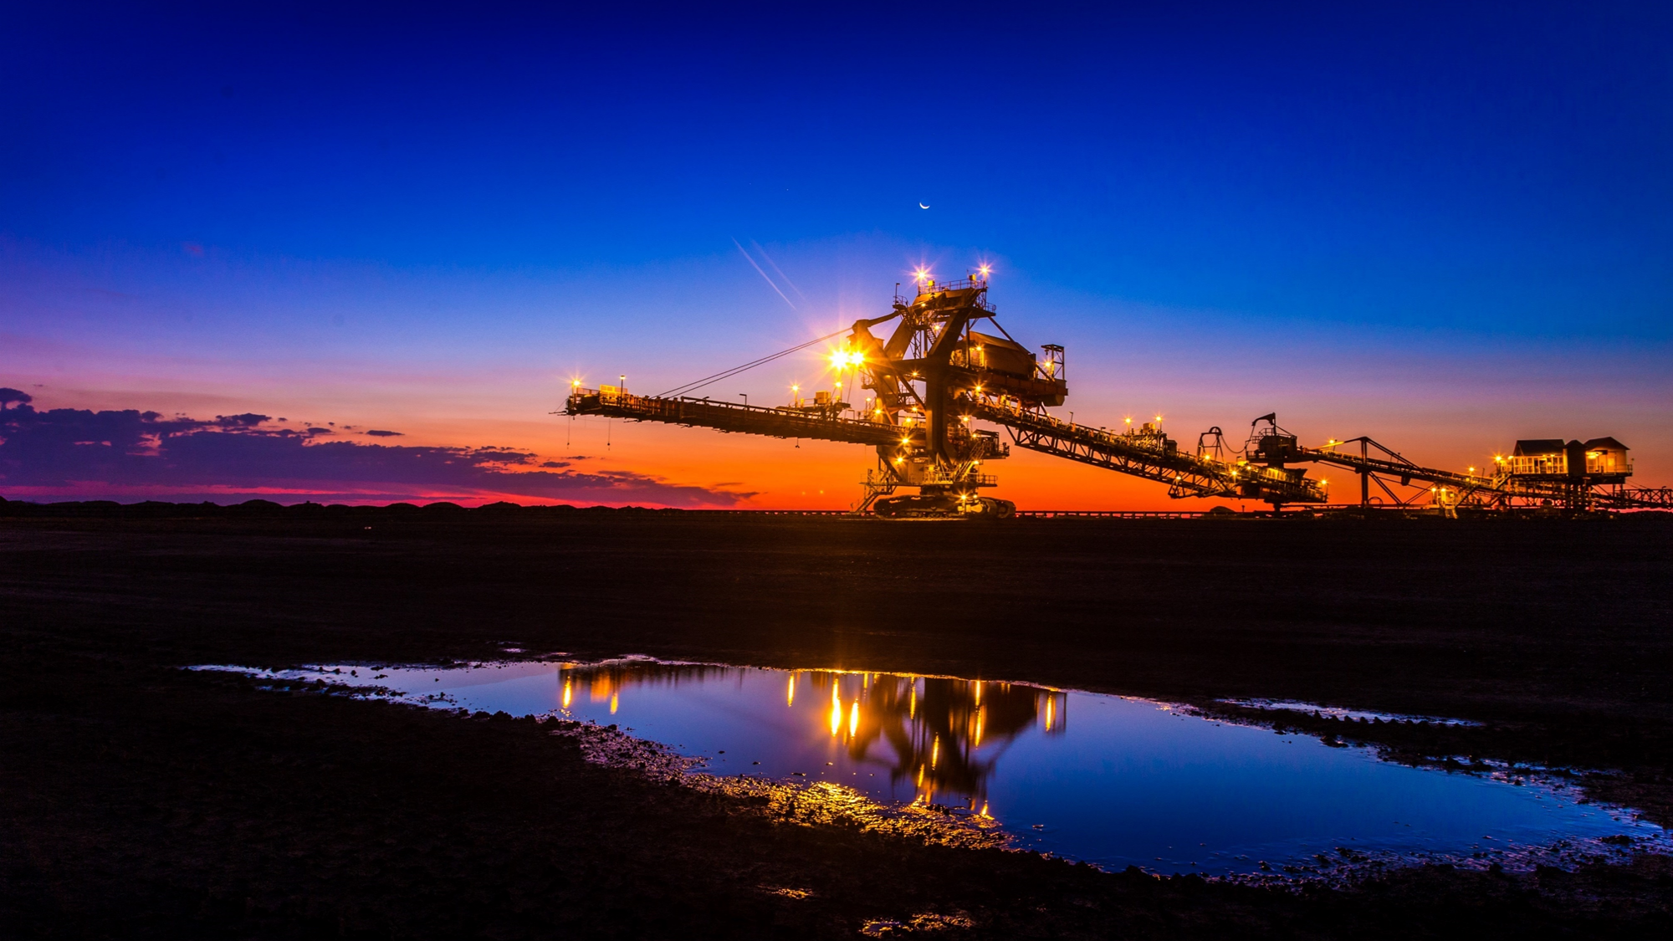
UNLOCKING VALUE
Notes:
No changes

Slide 9
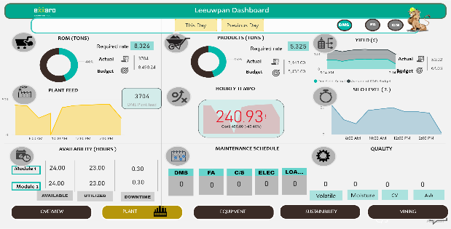
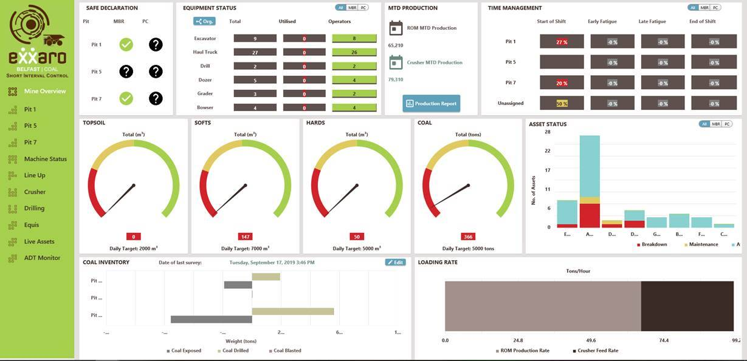
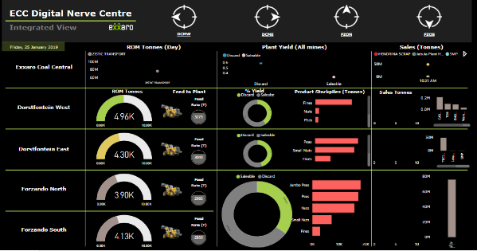
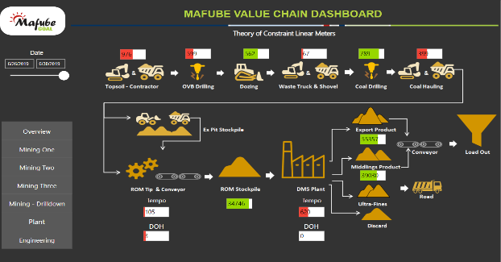
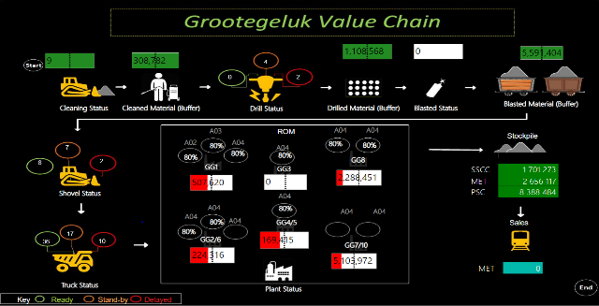
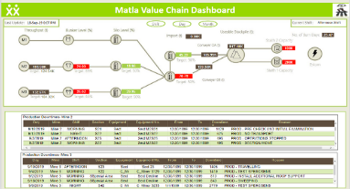
Unlocking Value | Visualisation of the Value Chain
The primary objective to visualise operational constraints in real time
LEEUWPAN
BELFAST
ECC
MAFUBE
GROOTEGELUK
MATLA

Slide 10
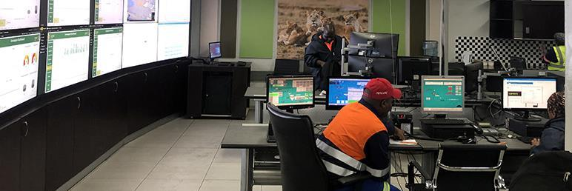
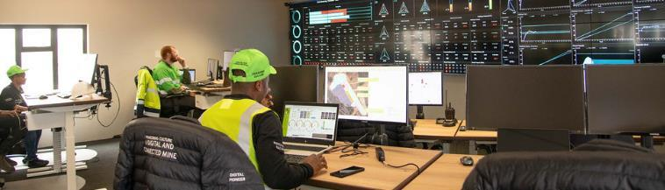
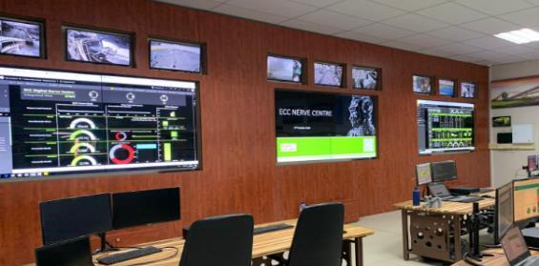
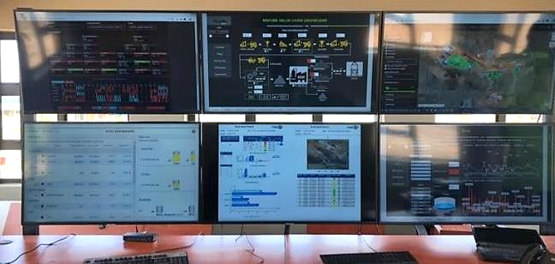
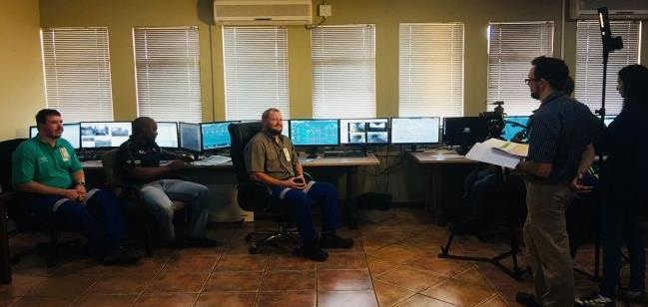
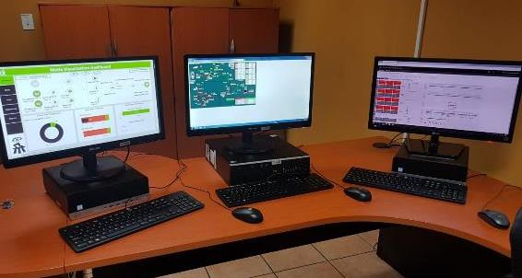
Unlocking Value | Integrated Operations Centres are implemented across all the business units
To drive real time decision making.
Drive Market to resource optimisation across the value chain.
Removing silos
LEEUWPAN - Lion Watch
BELFAST - Integrated Operations Hub
ECC - Nerve Centre
MAFUBE - High Point
GROOTEGELUK - Ops Eye
MATLA - Integrated Operations Centre

Slide 11
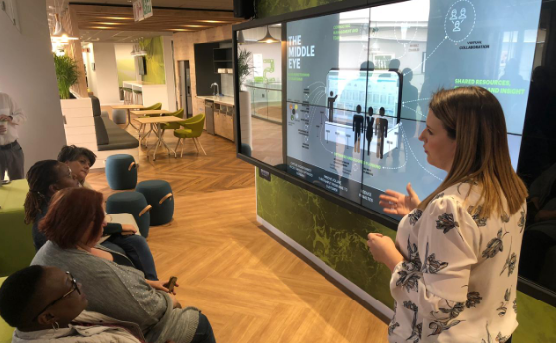

“Connecting Bias for Action”
Integrated Management Platform
Market to Resource Integration
Integrated Planning
Shared Resources
Functional Integration for Bussiness Excellence

Slide 12







Unlocking Value | Market2Resource Optimisation
Using Artificial Intelligence to scan the market to guide the optimal product mix
Digitally Integrated Mine Planning to optimise product mix and sales
Real Time Visualisation of our ore, integrating TFR & Logics for optimal decision making
Using Data science and AI to gather intelligence on markets for efficient resource optimisation (positioning & pricing)
Blending
options
Blending options
Mining
Logistics
Port and Shipping
MARKET
Value Chain Visualisation
Opportunities to Leverage blockchain to manage outbound logistics
We are using “Digital@Exxaro” to close value leaks across the business value chain

Slide 13
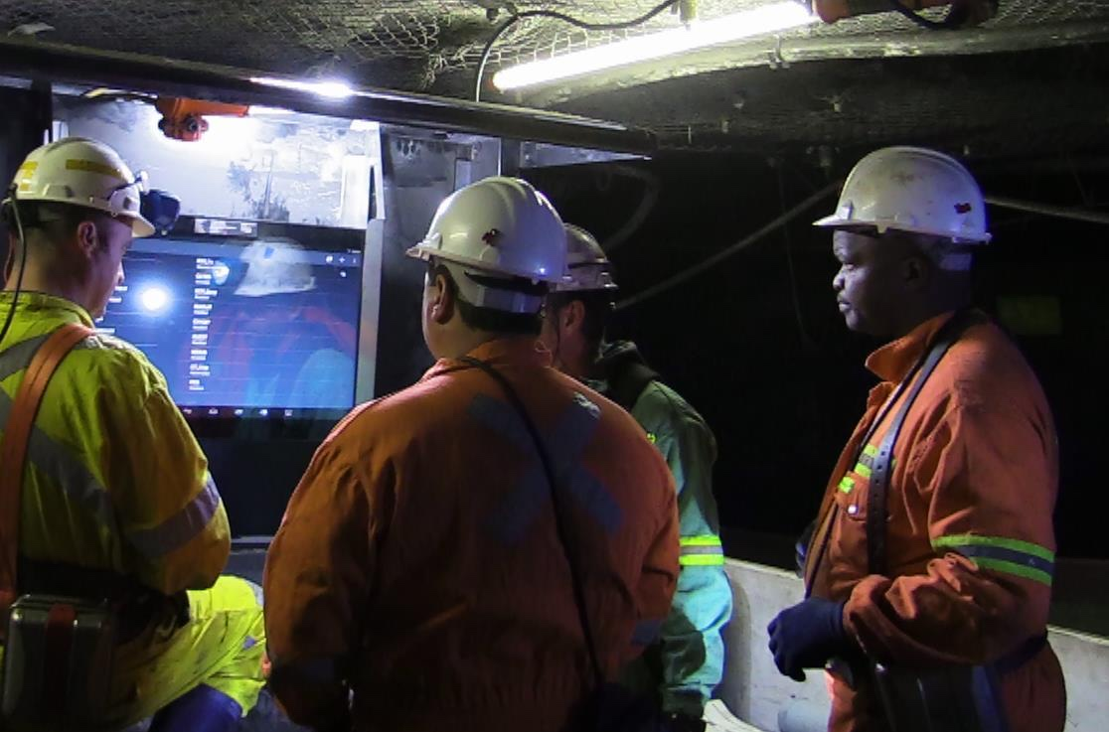
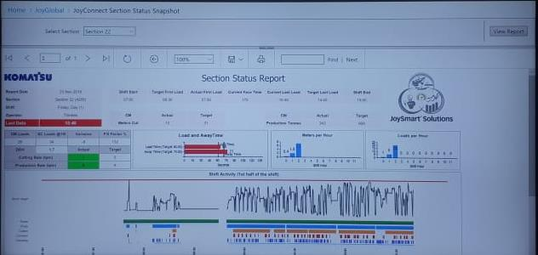
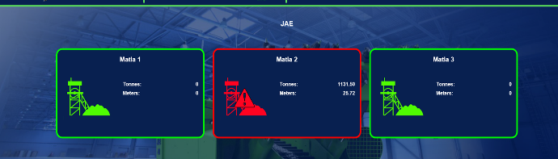
Unlocking Value | Underground Real Time Decision Making

Slide 14
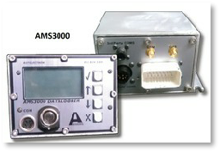
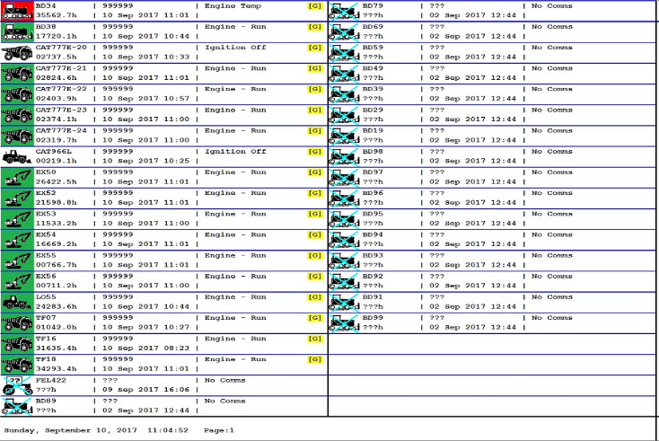
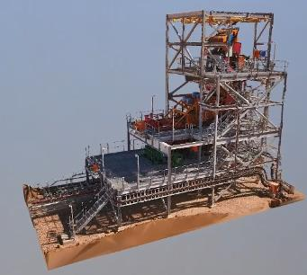
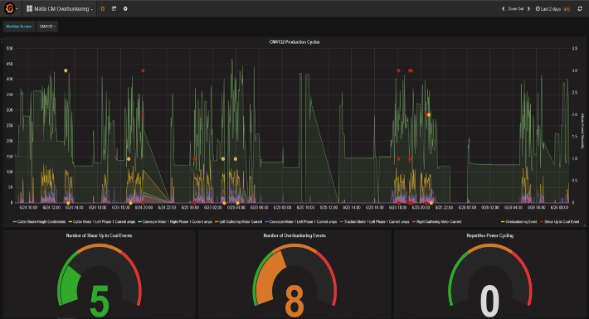
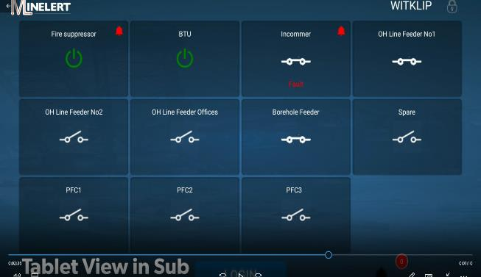
Unlocking Value | Using Data Science for Predictive Maintenance and Analytics (Digital Twin )
Data Science Analytics: can be run and visualised via smart devices, virtual reality and augmented reality (AR) to provide operational intelligence.

Slide 15
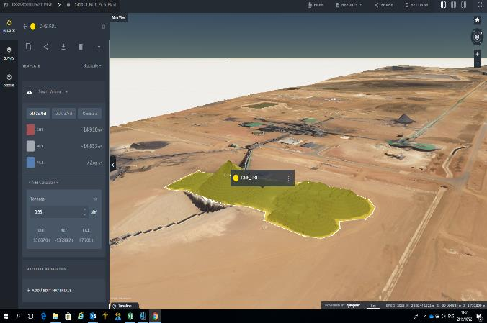
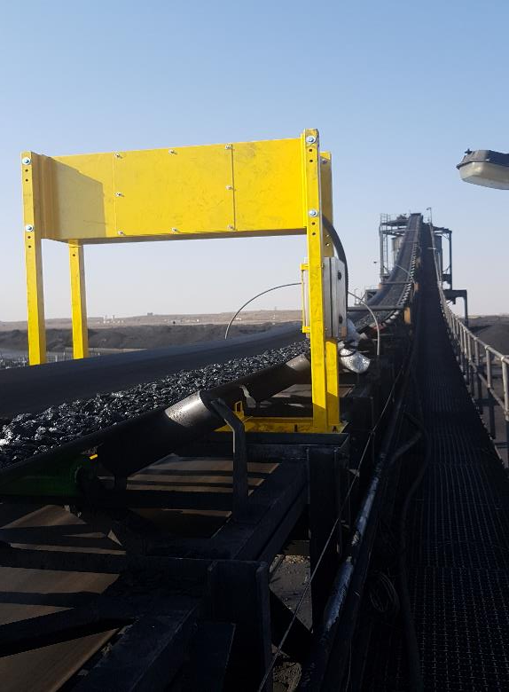
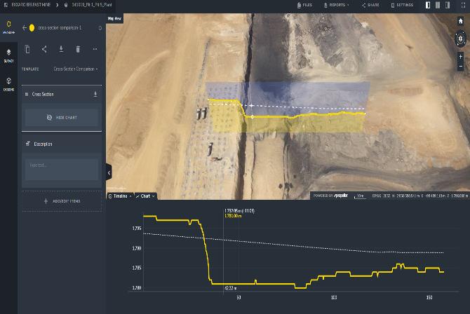
Unlocking Value | Mineral Resource Integration
Business unit MVPs recently concluded.
LEEUWPAN – ENELEX
On-line (real time) radiometric coal ash content analyser, to help with quality monitoring.
Tracing the loss of product to the discard (Misplacement).
Used as an indicator to process inefficiencies.
Assist Plant and Geologist for better planning and decision making.
BELFAST - Trimble Stratus
Use drones to map, measure and share accurate information about worksites and assets.
Get accurate, up-to-date topographic surveys
Calculate overall material volumes added or removed from pits, stockpiles
Measure distances, slopes and heights

Slide 16
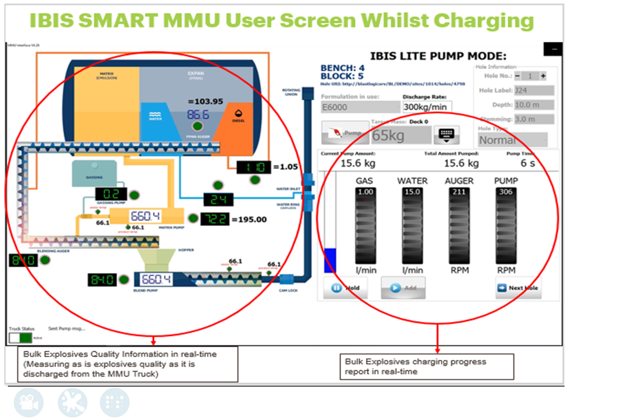
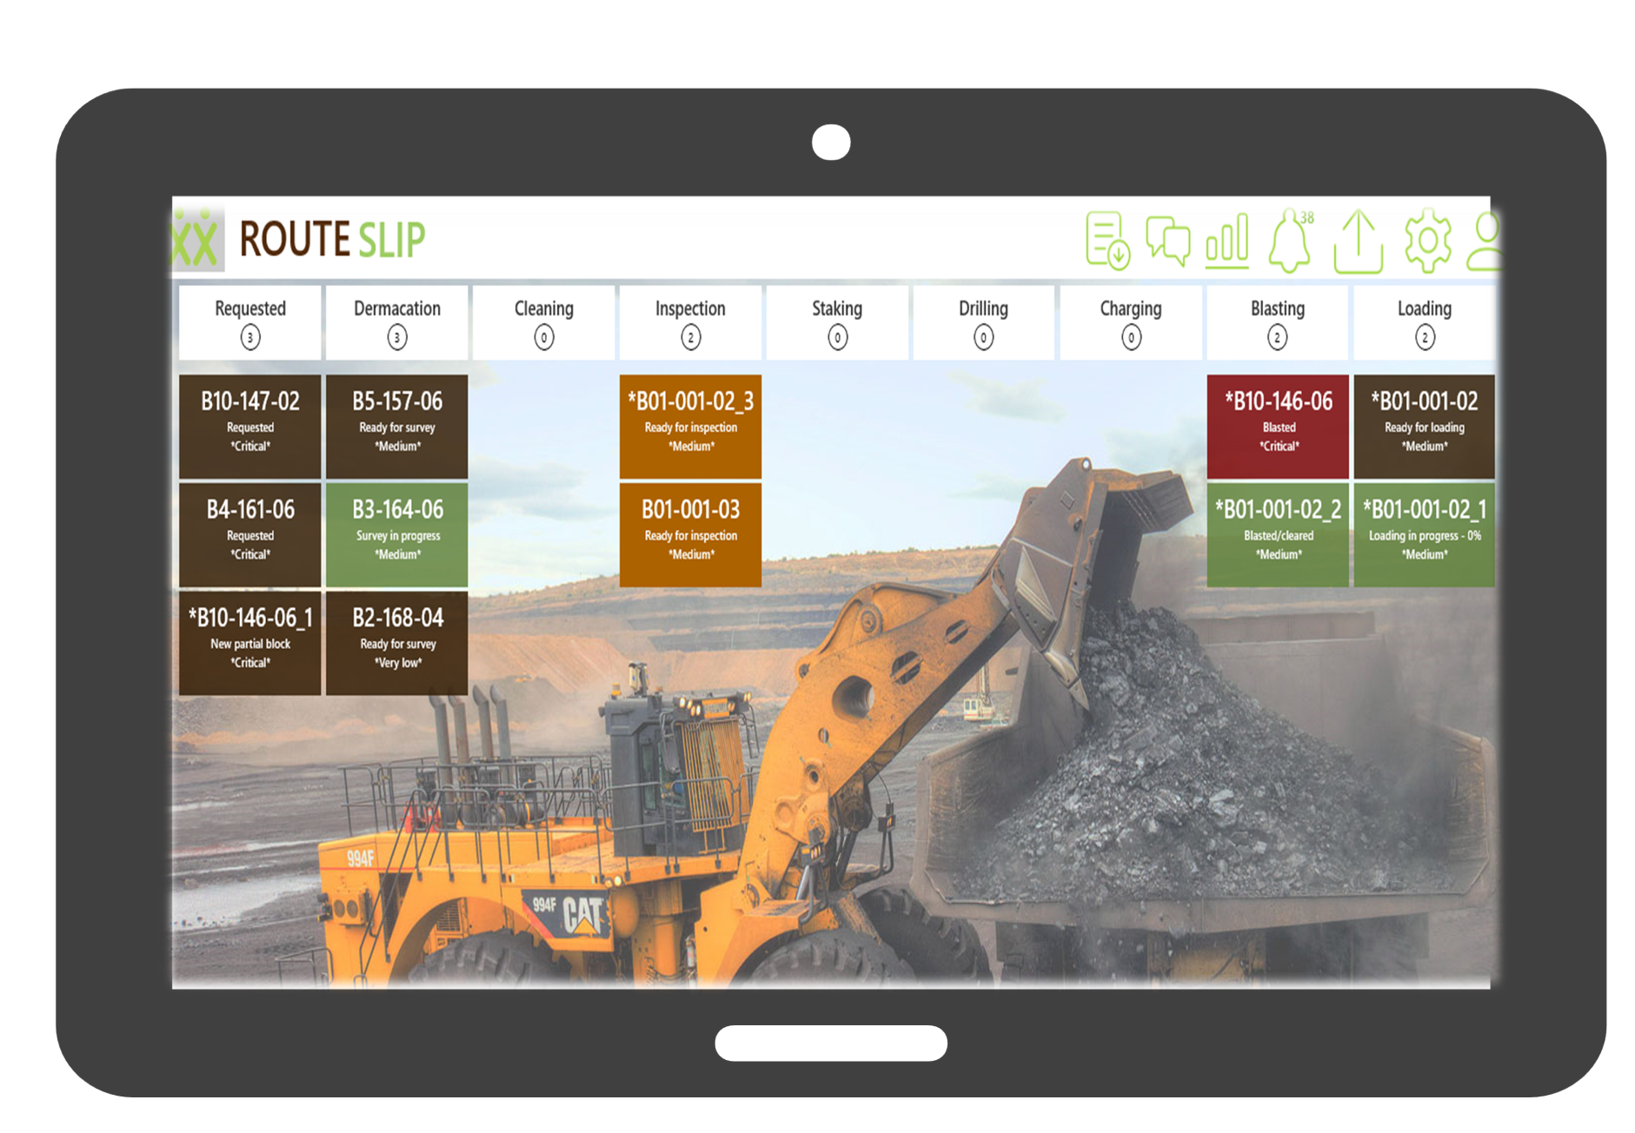
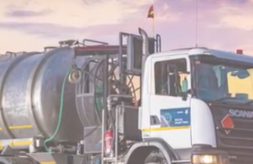
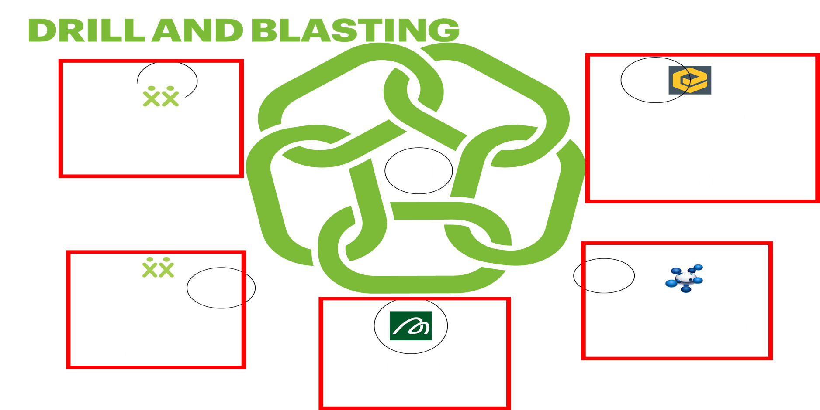
Digital@Exxaro │ Mineral Resource Integration
Fragmentation Optimisation
Digital Route Slip to Track The Ore

Slide 17
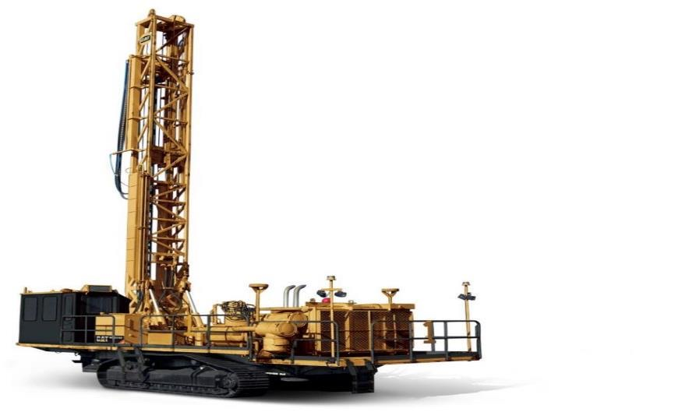
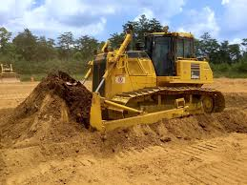
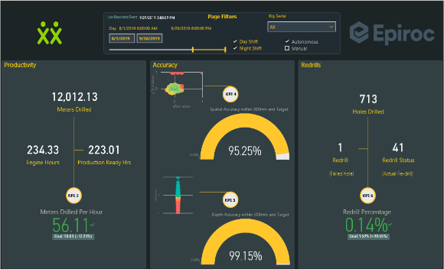
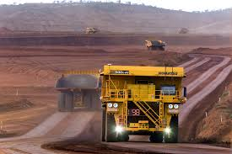
Unlocking Value | Automation
1
We are targeting high value easy and affordable to integrate parts of our value chain to convert to autonomous operations. i.e Dozers, Plants, Drills,etc.
2
Managing and Integrating autonomous operations and processes in a mine is complex as these operate sub-optimally alongside manually driven processes
3
Although we are constantly evolving our culture, this remains a very labour sensitive issue.
Results: (prelim value, still doing time studies checking if data in the system is correct)
56m/hr vs YTD of 45m/hr for old drills

Slide 18
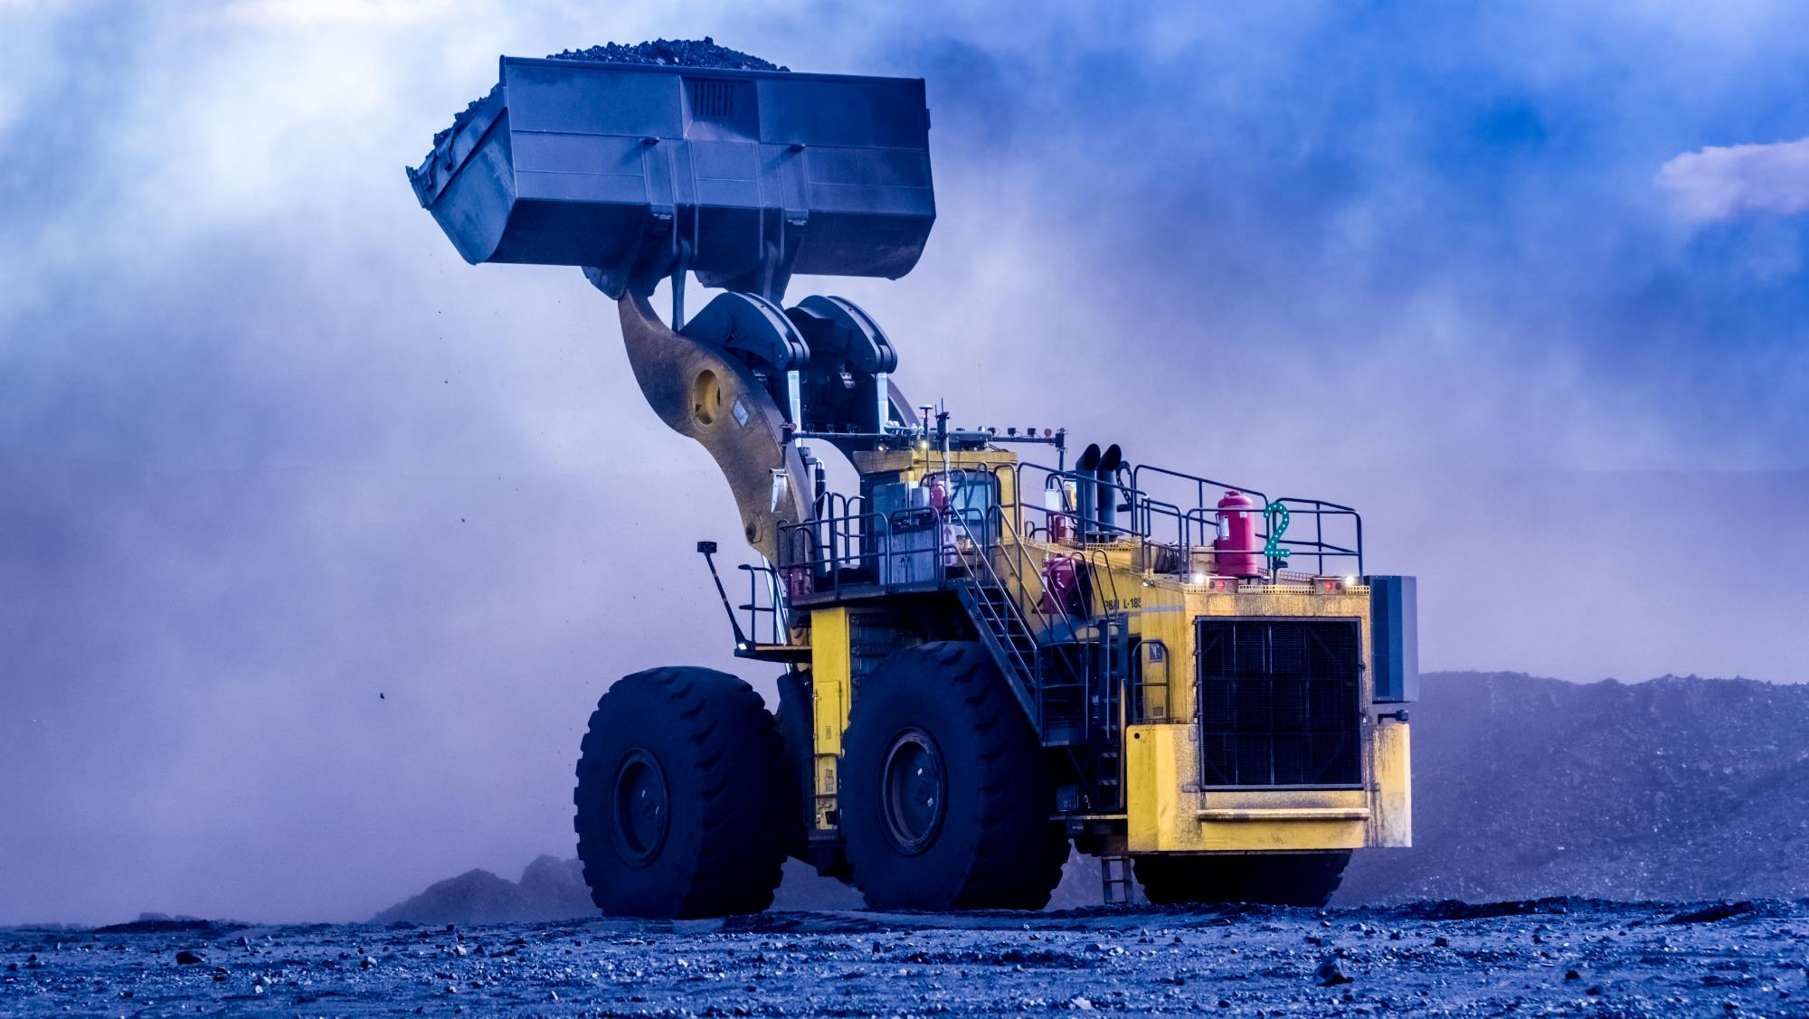
VALUE REALISED
Notes:
No changes

Slide 19
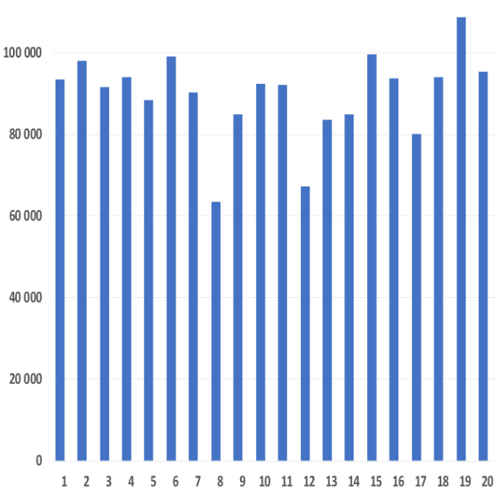
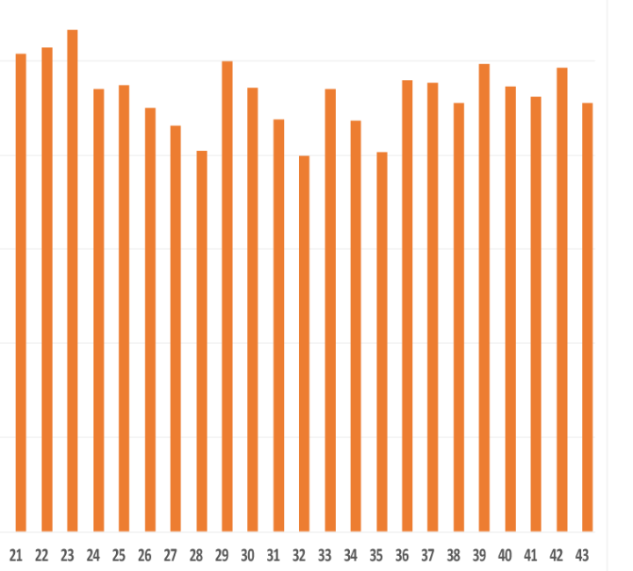
Value Realised│ GG IOC (ops eye) MVP completed in 2018
Average Ex-pit Tonnes per shift
Ops-Eye Period
Before Ops-Eye
93 932
89 740
5%
GG2 on Shut (±10% of overall plant capacity)
IMPROVEMENT
weeks

Slide 20
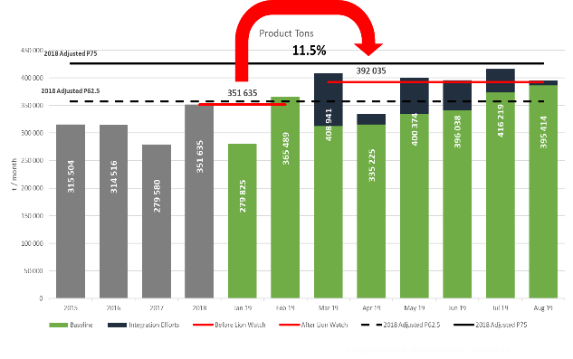
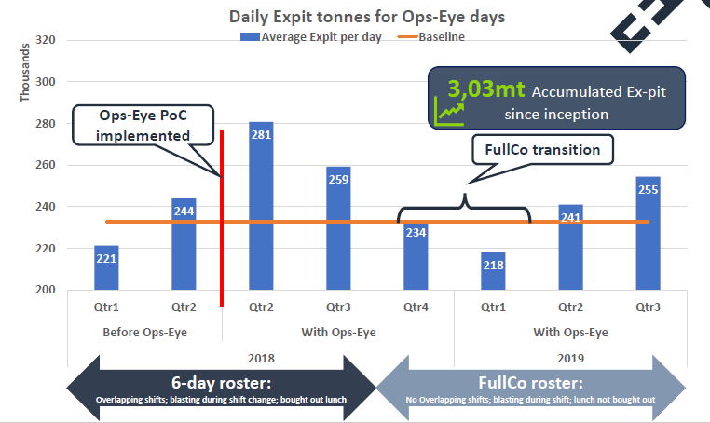
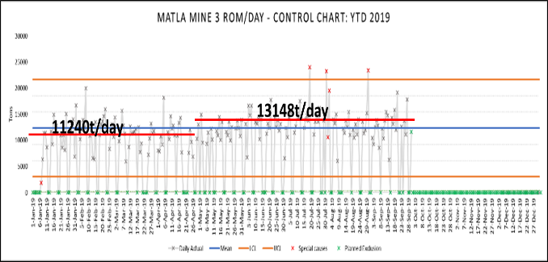
Value Realised│ Integrated Operations Centres
… CONTINUE TO DEMONTRATE IMPROVEMENT AT OTHER OPERATIONS IN 2019
LEEUWPAN
Lion Watch
11.5% YTD
Product tons
3.03mt Product tons
GROOTEGELUK
Ops Eye (MVP)
5% YoY over 5 yrs
16% MINE3
Product tons
Estimated 16% Improvement
BELFAST
Integrated Operations Hub
MATLA
Integrated Operations Centre (MVP)

Slide 21
START UP CULTURE
Notes:
No changes

Slide 22
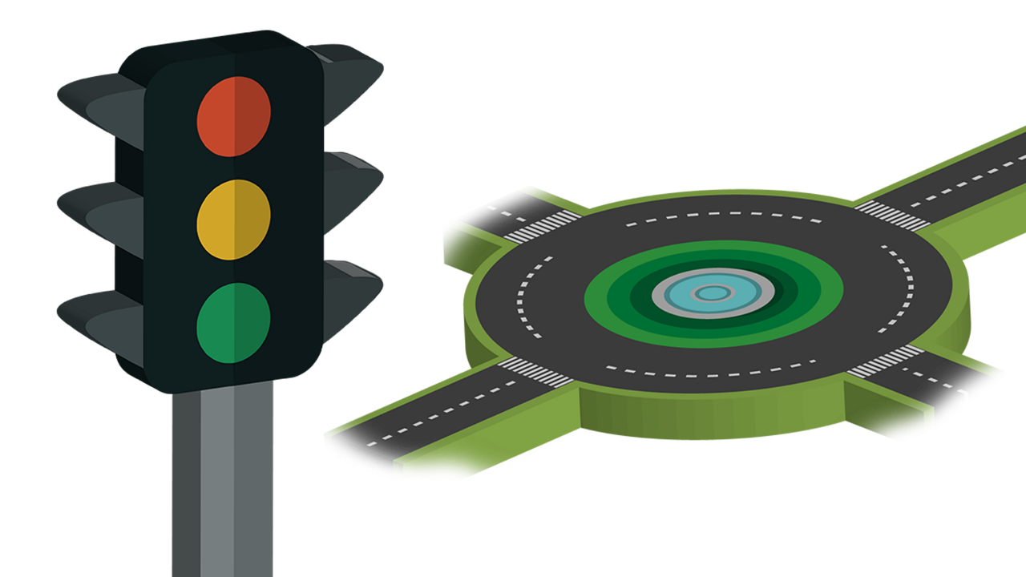
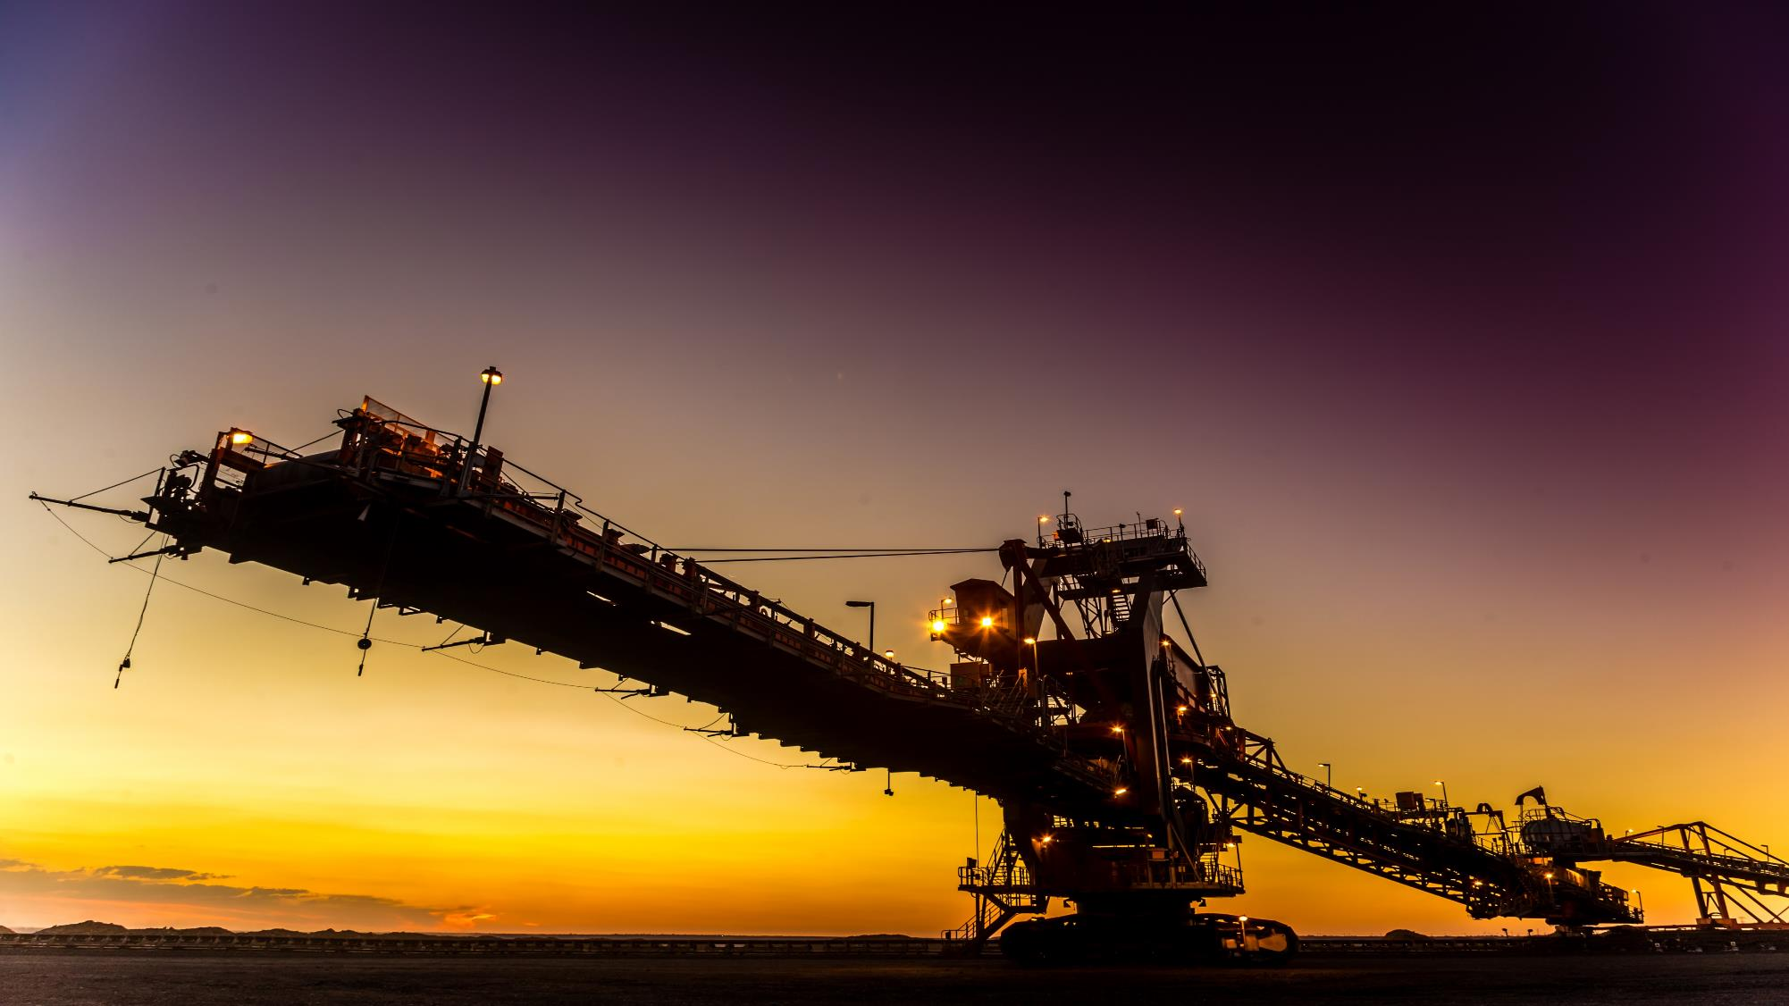

Slide 23

EXECUTION
vs
DISCOVERY

Slide 24
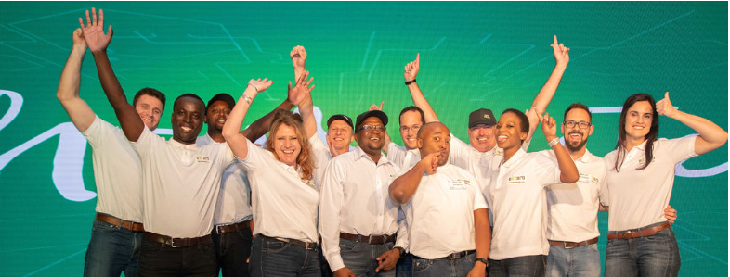
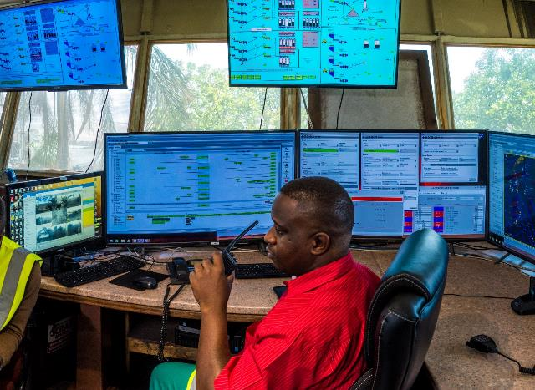


Start up Culture | Culture Drive to Entrench Adoption

Slide 25

WHAT’S NEXT?
Notes:
No changes

Slide 26
What’s Next | Exxaro to be a mining and resource “Innovation Magnet”
Governance Model
Executive Sponsor
We understand the real operational problems that miners are facing, therefore are able to detail the user requirements for solution development
Steering Committee
(~Monthly)
We have a vast amount of technical IP in mining and therefore we are co-developing custom solutions with the technology providers
Program Management
(Weekly)
We have operational assets and therefore we are able to offer pilot testing in a real operational environment that technology companies desperately need.
Delivery Team
(Daily Agile Scrums)
Workstreams
We are upskilling our workforce to be able to manage in a data driven organization and systems (e.g. through the IOC`s and data science)
Digital Value Chain Lead
Business Improvement Facilitators

Slide 27

MAKE DIGITAL
TRANSFORMATION
PAY FOR ITSELF
Notes:
No changes

Slide 28

TECHNOLOGY IN MINING can REDUCE the fixed cost in mining
Notes:
No changes

Slide 29

WE ARE FOCUSING ON
ORGANISATIONAL TRANSFORMATION
NOT POINT SOLUTIONS
Notes:
No changes

Slide 30

THANK YOU
Pleasure Mnisi
Business Optimisation
Exxaro

